Slide 1


Virtual Instructor-led Training on Scrum Product Owner Certified (SPOC™) Certification

Slide 2
Ground Rules/Working Agreements
This is a two-day class. Class starts at 8:00 A.M. and will continue until 4:00 P.M. each day. Your instructor will provide breaks throughout the day.
Participants should be in the class on time and return from breaks as instructed.
Full participation is expected from students. Please join in the activities and exercises as instructed.
The study materials and resources that participants will be using are copyrighted and wholly owned by SCRUMstudy. These should not be photocopied, distributed, or shared and may only be used by students who have enrolled in SCRUMstudy classroom training.

Slide 3
Course Objectives
To provide deep understanding of the Scrum framework’s philosophy and principles
To provide practical knowledge of Scrum from a Product Owner’s perspective—including roles, meetings, and artifacts
To prepare participants to be comfortable in taking on the role of Product Owner in their organizations as well as to manage common issues and roadblocks
To prepare students to take and PASS the Scrum Product Owner Certified (SPOCTM) exam!

Slide 4
Course Outcomes
Delegates will be familiar with the concepts, advantages, and challenges of the Scrum framework.
Delegates will be adept in handling the business aspects of the Scrum framework and stakeholder engagement.
Delegates will be equipped with the knowledge needed to play the role of a Product Owner in their organizations and help their organizations adopt the Scrum framework. This knowledge will include a functional understanding of the other roles in Scrum.
Delegates will have knowledge pertaining to and the ability to anticipate issues related to the practical implementation of Scrum

Slide 5
Format of the Training
For each topic, the faculty explains the concept
Participants attempt multiple choice questions
Participants ask questions and have discussion with the faculty

Slide 6
Syllabus Areas
1. Agile Overview
2. Domains of Agile Practices
3. Scrum Overview
4. Overview of the SBOK Guide
5. Scrum Principles
6. Scrum Aspects
7. Scrum Phases and Processes
8. Transitioning to Scrum

Slide 7
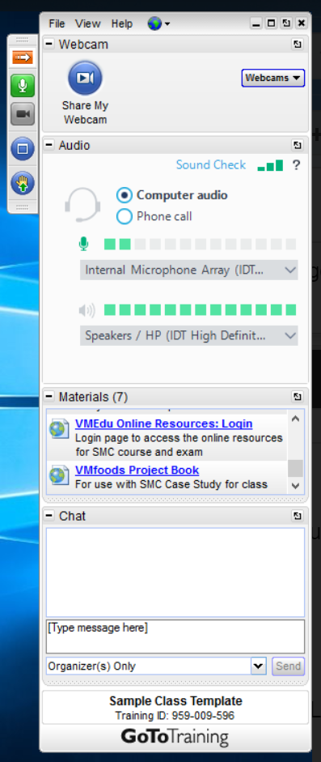
VIRTUAL Classroom
How to participate in this Virtual Classroom:
Virtual Classroom Toolbar:
Expand/Collapse Toolbar
Mute (pls mute when not talking)
Webcam – please turn on
Toggle Full screen/Window view
Raise/Lower Hand
Send messages to the instructor

Slide 8
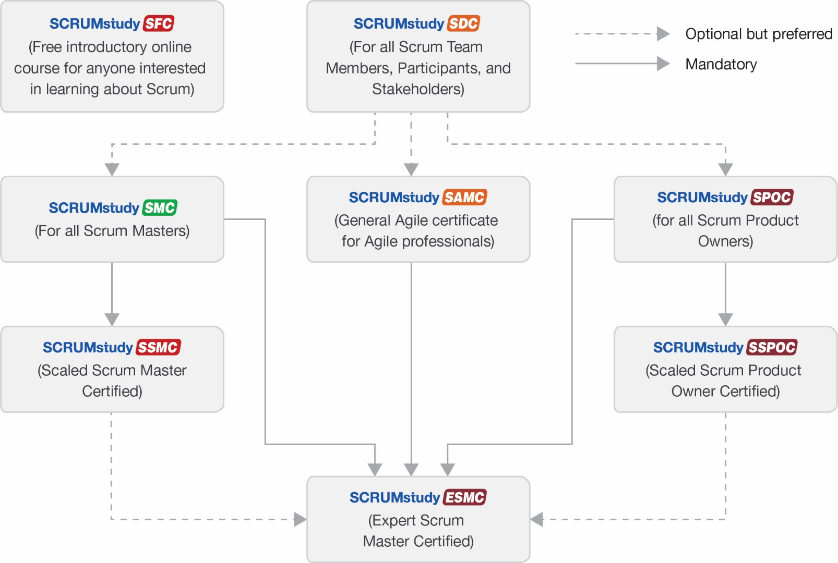
SCRUMstudy Certification Schema
All Certification Exams of SCRUMstudy are proctored online. Participants will need a computer and webcam to take the exam, which will be proctored live by VMEdu.

Slide 9
Scrum Product Owner Certified Exam
Multiple Choice
140 Questions per Exam
No Negative Marks for Wrong Answers
180 Minutes Duration
Proctored Online Exam

Slide 10

Scrum Product Owner Certified Certification Training

Slide 11
Agile Overview

Slide 12
Projects and Project Management
A project is a collaborative enterprise to either create new products or services or to deliver results as defined in the Project Vision Statement.
Projects are usually impacted by constraints of time, cost, scope, quality, benefits, and risks.
The objective of the project team is to create Deliverables as defined in Prioritized Product Backlog.
Project management activities include planning, delegating, executing, monitoring and control.

Slide 13
How is a project different from Business Operation, Programme, and Portfolio

Slide 14
Introduction to Agile Frameworks
The popular Agile frameworks include:
  Lean Kanban
  Extreme Programming
  Crystal Methods
  Dynamic Systems Development Methods
  Feature Driven Development
  Test Driven Development
  Adaptive Software Development
  Agile Unified Process
  Domain-Driven Design

Slide 15
The Need for Agile?
Rapidly changing market and technology—the need to be cutting edge
Reduction of testing and experimentation costs (simulations and automation)
Customer value is delivered at point of sale, not at the point of plan
Shrinking the “time to market” of products and increased innovation demands from customers
Need for an adaptive method of development rather than traditional, predictive methods

Slide 16
Agile Manifesto - Values
“We are uncovering better ways of developing software by doing it and helping others do it. Through this work, we have come to value the following:
That is, while there is value in the items on the right, we value the items on the left more.”
Individuals and interactions | Over | Processes and Tools
Working software | Over | Comprehensive Documentation
Customer collaboration | Over | Contract Negotiation
Responding to change | Over | Following a Plan

Slide 17
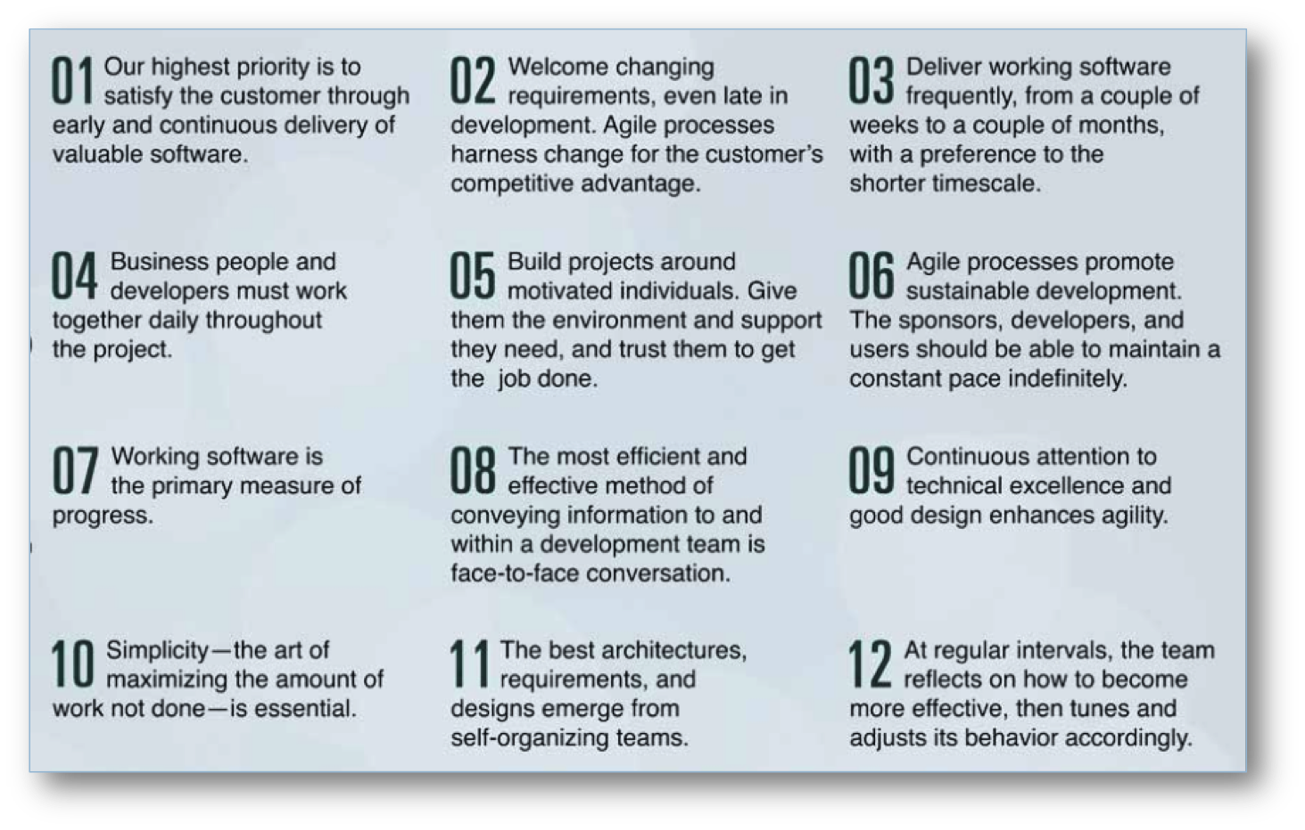
Agile Principles

Slide 18
Declaration of Interdependence
Declaration of Interdependence
Agile and adaptive approaches for linking people, projects, and value
We are a community of project leaders that are highly successful at delivering results. To achieve these results:
We increase return on investment by making continuous flow of value our focus.
We deliver reliable results by engaging customers in frequent interactions and shared ownership.
We expect uncertainty and manage for it through iterations, anticipation, and adaptation.
We unleash creativity and innovation by recognizing that individuals are the ultimate source of value and by creating an environment in which they can make a difference.
We boost performance through group accountability for results and shared responsibility for team effectiveness.
We improve effectiveness and reliability through situation specific strategies, processes, and practices.

Slide 19
Question
Which of following statements is NOT True?
Agile team size is small, whereas Waterfall team size is generally large.
The ROI in Agile is throughout the project life, whereas in Waterfall it is, generally, at the end of the project.
Agile management is autocratic, whereas Waterfall management is decentralized.
Agile requires minimal documentation, whereas Waterfall practices comprehensive documentation.

Slide 20
Answers Will be Provided by the Faculty

Slide 21
Question
Identify the INCORRECT Agile principle and its implications.
Business people and developers must work together daily throughout the project: it is mandatory for the stakeholders and the team to meet and converse daily.
Continuous attention to technical excellence and good design enhances agility: it keeps the software maintainable.
The best architectures, requirements, and designs emerge from self-organizing teams: self-organizing teams have a higher level of ownership in the designs they create.
Deliver working software frequently: this ensures timely feedback that can be incorporated early in the product development process.

Slide 22
Answers Will be Provided by the Faculty

Slide 23
Question
Which of the following is NOT implied by the Agile principle, “At regular intervals, the team reflects on how to become more effective and then tunes and adjusts its behavior accordingly”?
Lessons are identified only at the end of the product development cycle as a part of Retrospective Meetings.
Change can be incorporated throughout the project, and not just at the end.
The team shall identify what works well and what does not.
The team should be flexible enough to adapt its behavior to the changes incorporated.

Slide 24
Answers Will be Provided by the Faculty

Slide 25
Question
Which principle is used to help effectively manage the duration of project planning and execution?
Time-Boxing
Collaboration
Value-based Prioritization
Self-organization

Slide 26
Answers Will be Provided by the Faculty

Slide 27

If you have any additional questions on this topic, please post it in the Question window.
Question
In your organization, are projects delivered in an hybrid environment or purely Agile or waterfall environment? Please type your answer in the Question window.

Slide 28
Domains of Agile Practices
Agile project activities can be organized into the following six major domains of practice:
Domain I: Value-Driven Delivery
Domain II: Stakeholder Engagement
Domain III: Team Performance Practices
Domain IV: Adaptive Planning
Domain V: Problem Detection and Resolution
Domain VI: Continuous Improvement

Slide 29
Value-driven Delivery
Agile methods aim to deliver value early in the project. Due to the unpredictable nature of product development, it becomes important to deliver important components as early as possible.
This early delivery of value provides an opportunity for reinvestment, as well as proving the worth of the project to interested stakeholders.
To provide Value-Driven Delivery, it is important to:
  understand what adds value to the customer;
  reduce risks that can potentially reduce the value if they occur;
  implement the plan that has been formulated based on the priorities determined.

Slide 30
Value-driven Delivery
Practices for Value-Driven Delivery
There are five practices that accompany this domain, each with its own tools, techniques, knowledge, and skills.
  Assessing Value
  Planning Value
  Delivering Value
  Confirming Value
  Tracking and Reporting Value

Slide 31
Value-driven Delivery
Assessing value
The value of business projects is estimated using methods such as Return on Investment, Net Present Value, and Internal Rate of Return.
  Return on Investment (ROI)
  Net Present Value (NPV)
  Internal Rate of Return (IRR)

Slide 32
Value-driven Delivery
Planning value
The responsibility for determining how the value will be created falls on the business team, while the development team must concentrate on what is to be developed.
Agile projects are typically dynamic and may require several adjustments during the course of project development. Thus, Agile charters should effectively outline processes that allow developers to make necessary changes while still ensuring that high-value components can be delivered.

Slide 33
Value-driven Delivery
Planning value
Value Stream Mapping uses flowcharts, also called visual maps, to illustrate the flow of information needed to complete a process.
Product Roadmap is a tool that provides a visual outline of the product and its key components. Story maps, popularized by Jeff Patton, are commonly used to illustrate product roadmaps.

Slide 34
Value-driven Delivery
Planning value
Prioritization
  Customer-valued prioritization
  Simple schemes
  MoSCoW prioritization scheme

Slide 35
Value-driven Delivery
Planning value
Prioritization
  Monopoly money
  100-point method
  Kano analysis

Slide 36
Value-driven Delivery
Delivering value
WIP limits
  Work In Progress (WIP) refers to work that has been undertaken but has not yet reached completion. Identifying bottlenecks in the project becomes difficult when several tasks are WIP at the same time. Each WIP item requires capital and does not contribute to ROI until it becomes a completed, usable product.
  Kanban boards are effective in placing limits on WIP. If the limit on WIP is too low, (that is, only a few processes are allowed to be WIP) then it may result in underutilizing the team.

Slide 37
Value-driven Delivery
Delivering value
Incremental delivery
  Incremental delivery is another method that can be used to maintain efficiency in delivering value during a project. In this method of delivery, functional increments of the product are deployed over the timeline of the project. The software can either be deployed for testing and evaluation, or it can be deployed for production in increments.

Slide 38
Value-driven Delivery
Confirming value
Prototypes, Simulations, and Demonstrations
  Demonstrating prototypes to customers and simulating their functionalities is an important practice in confirming value.
  Often, after demonstrating and using the features, customers can more clearly assess whether the features are adequate and suitable. They might realize that they need additional features. In product development, the description for this customer experience has come to be known as “I’ll Know It When I See It”.
  Through demonstrations, customers can also evaluate to what degree the team has successfully interpreted the product requirements and built them accordingly. This is known as the “gulf of evaluation.”

Slide 39
Value-driven Delivery
Tracking and Reporting value
Agile Earned Value
  Earned Value Management focuses on predicting the time it will take to complete the project and the final cost incurred.
  Earned Value Analysis uses visuals in the form of graphs as a primary way to report status.

Slide 40
Value-driven Delivery
Tracking and Reporting value
Cumulative Flow Diagrams (CFDs)
  Cumulative Flow Diagrams give valuable insight into the project status and are important tools to track and report Agile projects.
  The shaded area shows the total number of features to be built. The dotted area represents the WIP, and the striped section shows the work that has been completed.
  CFDs provide a visual of how the project is performing. It is a great tool to identify roadblocks and bottle neck processes.

Slide 41
Value-driven Delivery
Tracking and Reporting value
Risk Burndown Chart
  The formula for calculating risk severity is Risk severity = risk probability X risk impact.
  Calculating risk severity can also help rank risk and response priorities and is not unique to Agile projects. However, Agile projects focus on creating value, and calculating EMV can assist in avoiding risks. Risk probability and risk impact both can be assigned scores of low (1), medium (2), and high (3). Using this formula, risk severity can be calculated on a numerical scale.

Slide 42
Question
Which of the following statement(s) is/are true for a Cumulative Flow Diagram (CFD):
  1. It is a useful tool for tracking and reporting project performance.
  2. It identifies roadblocks and bottlenecks within processes.
  3. It is usually used to provide daily updates for individual Sprints.
  4. It provides a simple, visual representation of project progress at a particular point in time
1 and 2
3 and 4
1, 2, and 4
1, 2, 3, and 4

Slide 43
Answers Will be Provided by the Faculty

Slide 44
Question
Which of the following is NOT a prioritization technique under Customer Value-based Prioritization?
MoSCoW Prioritization Scheme.
Monopoly Money.
Kano Analysis.
20-point Prioritization Scheme.

Slide 45
Answers Will be Provided by the Faculty

Slide 46
Question
Which of the following concepts regarding iterative development should an Agile team be aware of?
The designing, developing, and testing of feature code should be done once in the beginning.
All changes should be addressed to at the end of the development phase.
There is room to accommodate changes.
Simplification of the development process is not a priority.

Slide 47
Answers Will be Provided by the Faculty

Slide 48
Question
Your team is working on creating software that raises and lowers a bridge to allow water traffic. You are considering several prioritization schemes to determine high-value features. Which among the following techniques should be in your list?
1. Kano analysis
2. Risk-based spikes
3. MoSCoW
4. T-shirt sizes
1, 2 and 3
2 and 4
1 and 3
2, 3 and 4

Slide 49
Answers Will be Provided by the Faculty

Slide 50
Stakeholder Engagement
There are four practices that accompany this domain, each with its own tools, techniques, knowledge, and skills, they are:
  Aligning Stakeholders’ Understanding
  Communicating with Stakeholders
  Using Critical Soft Skills
  Leading Effectively

Slide 51
Team Performance Practices
To be successful on Agile projects, it is important to understand how and when teams perform best and how to create an empowered team. This will be discussed in two parts.
The first part deals with concepts related to understanding team performance, and the second part deals with team practices.

Slide 52
Adaptive Planning
There are three practices that accompany this domain, each with its own tools, techniques, knowledge, and skills:
  Planning Concepts
  Estimation
  Agile Plans

Slide 53
Problem Detection and Resolution
Problems are an inevitable part of any project. Proactively identifying and resolving problems is crucial.
Identifying problems
  Cycle time
  Escaped defects
  Project and quality standards
  Failure modes and alternatives
  Variance and trend analysis
  Control limits
Resolving problems
  Continuous integration
  Risk-based spike
  Frequent verification and validation
  Steps in solving problems

Slide 54
Continuous Improvement
Several tools, techniques, knowledge sets, and skills can continuously improve Agile projects:
  Retrospectives,
  Knowledge sharing,
  Process tailoring
  Principles of systems thinking
  Process analysis
  Applying new Agile practices
  Continuous improvement processes
  Self-assessment
Agile tools and artifacts:
  User stories and backlogs
  Requirements hierarchy
  Information radiators
  Burndown and burnup charts
  Agile modeling

Slide 55
Question
Sponsors are stakeholders who fund the project. As part of stakeholder engagement, the Product Owner needs to make sure that the Sponsors have clarity about all of the following, EXCEPT:
Performance of individuals within the project team
Risks involved in the project and the steps or strategies to mitigate them
Deadline targets and the overall cost of the project
Benefits of Scrum implementation

Slide 56
Answers Will be Provided by the Faculty

Slide 57
Question
Though it is not the main role of the Scrum Master to interact directly with stakeholders on a project, yet he/she should be aware of the importance of maintaining stakeholder involvement. Which of the following statements is NOT true for stakeholder involvement in a Scrum project?
The responsibility for keeping stakeholders engaged lies with the Product Owner.
Regular communication must be maintained with stakeholders.
Stakeholders should be informed about the target Releases and estimated cost of the project.
Stakeholders should be consulted while appointing people to Scrum Team.

Slide 58
Answers Will be Provided by the Faculty

Slide 59
Question
Which of the following statements is FALSE about the concept of ‘Continuous Improvement’?
Learn lessons from previous projects
Learn lessons from the current project
Learn lessons only at predefined intervals
Pass lessons for future projects

Slide 60
Answers Will be Provided by the Faculty

Slide 61
Question
Find the total cycle time of the following process:
A Scrum team spends 10 minutes to gather for the Daily Standup meeting, spends 15 minutes in the meeting, 10 minutes for a quick session to identify issues that need immediate attention followed by another 5 minutes to discuss last night’s baseball game. Note that the first and the last events are not “value-adding” activities.
25 minutes
40 minutes
30 minutes
15 minutes

Slide 62
Answers Will be Provided by the Faculty

Slide 63
Overview of Scrum

Slide 64

Scrum Overview
A Scrum project involves a collaborative effort to create a new product, service, or other result as defined in the Project Vision Statement.
Projects are impacted by constraints of time, cost, scope, quality, resources, organizational capabilities, and other limitations that make them difficult to plan, execute, manage, and ultimately succeed.
However, successful implementation of the results of a finished project provides significant business benefits to an organization.
It is therefore important for organizations to select and practice an appropriate project management approach.

Slide 65
What is Scrum?
Scrum is one of the most popular Agile methods. It is an adaptive, iterative, fast, flexible, and effective framework designed to deliver significant value quickly and throughout a project.
Scrum ensures transparency in communication and creates an environment of collective accountability and continuous progress.
The Scrum framework, as defined in the SBOK™ Guide, is structured in such a way that it supports product and service development in all types of industries and in any type of project, irrespective of its complexity.
A key strength of Scrum lies in its use of cross-functional, self-organized, and empowered teams who divide their work into short, concentrated work cycles called Sprints.

Slide 66
History of Scrum

Slide 67
History of Scrum - Rugby Approach
Inception of the Framework in the 1980s
Developed by Hirotaka Takeuchi and Ikujiro Nonaka
Described an innovative approach to product development that they called a holistic or “Rugby” approach
Defined a flexible and all-inclusive product development strategy
Approach based on manufacturing case studies from different industries
Product development should not be like a sequential relay race, but rather should be analogous to the game of Rugby

Slide 68
History of Scrum
2013 - A Guide to the Scrum Body of Knowledge (SBOK™ Guide) First Edition is released. It is developed with the help of more than 52 subject matter experts from over 10 countries.
2015 - A Guide to the Scrum Body of Knowledge (SBOK™ Guide) Second Edition is released.
2015 – SCRUMstudy LinkedIn Group is formed. It is now the largest and the fastest growing community of Scrum and Agile practitioners with over 72,000+ members.
2017 - A Guide to the Scrum Body of Knowledge (SBOK™ Guide) Third Edition is released with detailed sections on Scaling Scrum for Large Projects and the Enterprise.

Slide 69
Why Scrum?

Slide 70
Scrum vs. Traditional Project Management
 | Scrum | Traditional Project Management
Emphasis is on | People | Processes
Documentation | Minimal—only as required | Comprehensive
Product delivery style | Iterative | Can be linear or iterative
Upfront planning | Low – through prioritization of requirements based on business value | Generally high – through various levels of plans
Quality assurance | Customer centric | Process centric
Management style | No levels of authority | Authority is delegated from one level to another
Change management | Through updates to Prioritized Product Backlog | Formal Change Management System
Leadership style | Collaborative, Servant Leadership | Command and control
Performance measurement | Business value | Plan conformity
Return on Investment (ROI) | Early/throughout project life | Generally, end of project life
Customer involvement | High throughout the project | Varies depending on the project lifecycle

Slide 71
Benefits of Scrum
Adaptability
Adaptability
Empirical process control and iterative delivery make projects adaptable and open to incorporating change.

Slide 72
Benefits of Scrum
Transparency
All information radiators such as Scrumboard and Sprint Burndown Chart are shared, leading to an open work environment.

Slide 73

Benefits of Scrum
Continuous Feedback
Continuous feedback is provided through the Conduct Daily Standup, and Demonstrate and Validate Sprint processes.

Slide 74
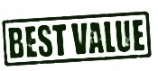
Benefits of Scrum
Continuous Delivery of Value
Iterative processes enable the continuous delivery of value through the Ship Deliverables process as frequently as the customer requires.

Slide 75
Benefits of Scrum
Sustainable Pace
Scrum processes are designed such that the people involved can work at a sustainable pace that they can, in theory, continue indefinitely.

Slide 76
Benefits of Scrum
value
Early Delivery of High Value
The Create Prioritized Product Backlog process ensures that the highest value requirements of the customer are satisfied first.

Slide 77

Benefits of Scrum
Faster Problem Resolution
Collaboration and colocation of cross-functional teams lead to faster problem solving.

Slide 78

Benefits of Scrum
Effective Deliverables
The Create Prioritized Product Backlog process and regular reviews after creating deliverables ensures effective deliverables to the customer.

Slide 79

Benefits of Scrum
Collective Ownership
The Commit User Stories process allows team members to take ownership of the project and their work leading to better quality.

Slide 80

Benefits of Scrum
Idea!
Innovative Environment
The Retrospect Sprint and Retrospect Project processes create an environment of introspection, learning, and adaptability leading to an innovative and creative work environment.

Slide 81
Question
The Product Owner, being a part of the Scrum Core Team, must ensure that he/she collaborates with the other team members and the stakeholders throughout the project. Which of the following statements is true about the particular project benefits realized due to collaboration within Scrum?
Collaboration helps identify the need for change in the process.
Collaboration enables prioritization of requirements by the Product Owner.
Collaboration enables all the team members and users to be on the same page in terms of project requirements.
Collaboration requires the exchange of tasks between the team members at regular intervals.

Slide 82
Answers Will be Provided by the Faculty

Slide 83
Question
Which among the following is not a key strength of Scrum?
Cross-functional teams
Self-organized teams
Empowered teams
Multi-tasking teams

Slide 84
Answers Will be Provided by the Faculty

Slide 85
Question
Which of the following is a benefit of Self-organization in Scrum?
Team buy-in and shared ownership.
The need for changes due to poorly clarified requirements is minimized.
Motivation, which leads to an enhanced performance level of the team.
Innovative and creative environment conducive to growth.

Slide 86
Answers Will be Provided by the Faculty

Slide 87
Question
Which of the following is NOT a benefit of using Scrum in projects:
Transparency
Customer centric
Individual Ownership
Continuous Improvement

Slide 88
Answers Will be Provided by the Faculty

Slide 89
If you have any additional questions on this topic, please post it in the Question window.
Question
How is performance of project teams is measured in your organization? Please type your answer in the Question window.

Slide 90

Overview of the SBOK™ Guide
A Guide to the Scrum Body of Knowledge (SBOK™ Guide) can be used as a reference and knowledge guide by both experienced Scrum and other product and service development practitioners, as well as by individuals with no prior experience or knowledge of Scrum or other project delivery methodology.

Slide 91
Framework of the SBOK™ Guide
The SBOK™ Guide is broadly divided into three areas of Principles, Processes and Aspects.
Scrum
Aspects
Scrum Processes
Scrum Principles
Figure 1-2: SBOK™ Guide Framework; Page 7 SBOK™ Guide

Slide 92
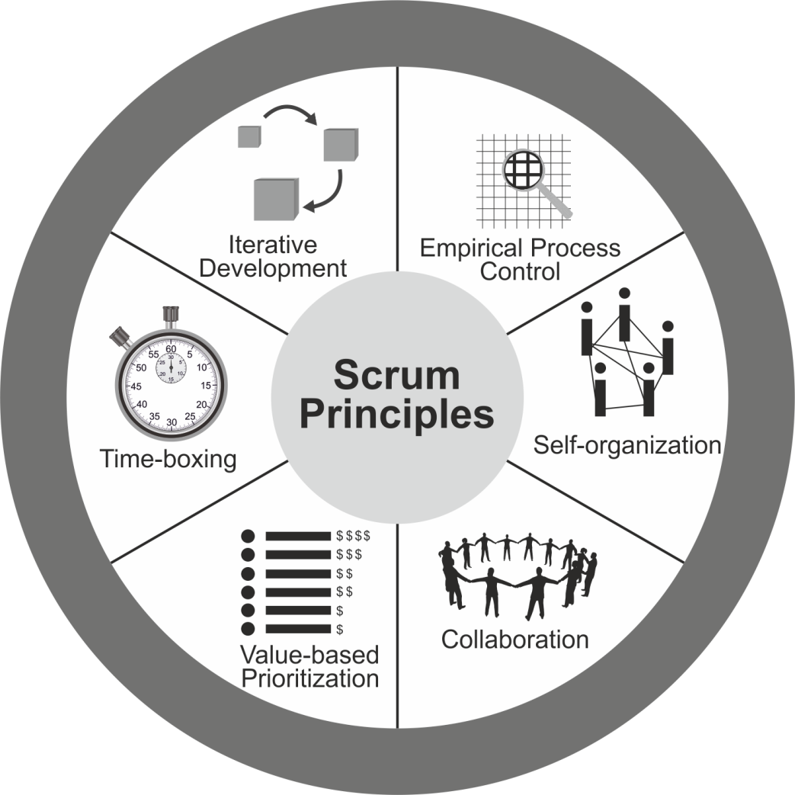
Scrum Principles
Figure 1‑3: Scrum Principles; Page 9
SBOK™ Guide
Scrum principles are the core guidelines for applying the Scrum framework and should mandatorily be used in all Scrum projects.
This topic will be discussed in detail later.

Slide 93
Scrum Aspects
Organization
Business Justification
Quality
Change
Risk
The Scrum aspects must be addressed and managed throughout a Scrum project.
This topic will be discussed in detail later

Slide 94
Scrum Phases and Processes
Table 1‑1: Summary of Fundamental Scrum Processes; Page 15 SBOK™ Guide
Chapter | Phase | Fundamental Scrum Processes
8 | Initiate | Create Project Vision Identify Scrum Master and Stakeholder(s) Form Scrum Team Develop Epic(s) Create Prioritized Product Backlog Conduct Release Planning
9 | Plan and Estimate | Create User Stories Estimate User Stories Commit User Stories Identify Tasks Estimate Tasks Create Sprint Backlog
10 | Implement | Create Deliverables Conduct Daily Standup Groom Prioritized Product Backlog
11 | Review and Retrospect | Demonstrate and Validate Sprint Retrospect Sprint
12 | Release | Ship Deliverables Retrospect Project
This topic will be discussed in detail later.
Scrum processes address the specific activities and flow of a Scrum project. In total there are nineteen fundamental Scrum processes that apply to all projects. These processes are grouped into five phases

Slide 95
Scrum Phases and Processes
For Scaling Scrum for Large Projects and Scaling Scrum for the Enterprise, that require coordination across multiple teams, there are eight additional Scrum processes.
Chapter | Applicability | Additional Scrum Processes
13 | Scrum for Large Projects | Create Large Project Components Conduct and Coordinate Sprints Prepare Large Project Release
14 | Scrum for the Enterprise | Create Program or Portfolio Components Review and Update Scrum Guidance Body Create and Groom Program or Portfolio Backlog Coordinate Program or Portfolio Components Retrospect Program or Portfolio Releases
This topic will be discussed in detail later.
Table 1‑2: Summary of Additional Scrum Processes; Page 16 SBOK Guide

Slide 96
Scrum Flow
Release Planning Meeting
Daily
Create Deliverables
Daily Standup
Meeting
Release Schedule
Sprint
1-6 weeks
Project Business Case | Project Vision Statement | Prioritized Product Backlog | Sprint Backlog | Accepted Deliverables
Project Vision Meeting
Sprint Planning Meeting
Sprint Review Meeting
Retrospect Spring Meeting
Figure 1-1: Scrum Flow for One Sprint; Page 2 SBOK™ Guide

Slide 97
Question
Which of the following situations would fit in with the Scrum framework?
There is a lot of paper work to be done at each step of the new product development.
Meetings have been taking place to lay down a comprehensive plan for the new product.
The development team has been functioning effectively without much intervention or supervision.
The change request cannot be implemented soon as it has to be approved by the management.

Slide 98
Answers Will be Provided by the Faculty

Slide 99
Question
Which of the following is true about Scrum?
Scrum should only be used for small projects
Scrum can only be used for software development
Scrum should only be used with teams of 6-10 people
Scrum can only be used for large corporations

Slide 100
Answers Will be Provided by the Faculty

Slide 101
Question
Scrum projects can be initiated once the _________________ is approved by the Sponsor?
Project Plan
Business Case
Project Initiation Documentation
Project Strategies

Slide 102
Answers Will be Provided by the Faculty

Slide 103
Question
Most of the pre-project work in Scrum is carried out by which of the following roles?
Product Owner
Scrum Master
Scrum Team
Scrum Guidance Body

Slide 104
Answers Will be Provided by the Faculty

Slide 105
If you have any additional questions on this topic, please post it in the Question window.
Question
Application of Scrum framework has been most successful in which industry? Please type your answer in the Question window.

Slide 106
Scrum Principles

Slide 107
Scrum Principles
Figure 1‑3: Scrum Principles; Page 9 SBOK™ Guide

Slide 108
Scrum Principles
The Scrum Principles are the foundation on which the
Scrum framework is based.
The Scrum principles can be applied to any
type of project or organization.
They must be followed in order to ensure an appropriate
and successful application of Scrum.
SCRUM
PRINCIPLES

Slide 109

Scrum Principles
Aspects and processes of Scrum can be modified.
The principles are non-negotiable and must be applied as described in the SBOK™ Guide.
Keeping the principles intact and using them appropriately gives confidence in the framework’s ability to help attain project objectives.

Slide 110
Scrum Principles – Empirical Process Control

Slide 111


Scrum Principles – Empirical Process Control
Scrum decisions are based on observation and experimentation

Slide 112
Scrum Principles – Empirical Process Control
Relies on three main ideas
Transparency
Inspection
Adaptation

Slide 113
Empirical Process Control - Transparency
Transparency allows all facets of any Scrum process to be observed by anyone.
This promotes an easy and transparent flow of information throughout the organization and creates an open work culture.

Slide 114
Empirical Process Control - Inspection
Inspection allows all facets of any Scrum process to be inspected by anyone.
This inspection could be to do with products, processes, or any other activity in a Scrum project.

Slide 115
Empirical Process Control - Adaptation
Adaptation happens as the Scrum Core Team and Stakeholders learn through transparency and inspection and then adapt by making improvements in the work they are doing.

Slide 116
Question
Which one of the following statements best describes Empirical Process Control?
This principle emphasizes the core philosophy of Scrum based on the three main ideas of transparency, inspection, and adaptation.
This principle focuses on today’s workers, who deliver significantly greater value when encouraged to self-organize rather than be subject to the command and control style of traditional project management.
This principle focuses on the three core dimensions related to collaborative work: awareness, articulation, and appropriation. It also advocates project management as a shared value-creation process with teams working and interacting together to deliver the greatest value.
This principle highlights the focus of Scrum to deliver maximum business value, beginning early in the project and continuing throughout.

Slide 117
Answers Will be Provided by the Faculty

Slide 118
Question
One of the principles of Scrum is Empirical Process Control. As a Product Owner, which of the following statements would you recognize as the best description of the Empirical Process Control?
Empirical Process Control model helps make decisions based on inputs and requirements that are clearly defined and sorted out.
Empirical Process Control model helps make decisions based on a particular input that will always provide a specific output.
Empirical Process Control model helps make decisions based on processes that generate unpredictable and unrepeatable outputs.
Empirical Process Control model helps make decisions based on observation and experimentation rather than on detailed upfront planning.

Slide 119
Answers Will be Provided by the Faculty

Slide 120
Question
Which of the following does not aid in ensuring transparency in a Scrum project?
Scrum ensures that the project has an open Prioritized Product Backlog with prioritized User Stories that can be viewed by everyone, both within and outside the Scrum Team.
Scrum ensures that there is clear visibility into the team’s progress through the use of a Scrumboard, Burndown Chart, and other information radiators.
Scrum ensures transparency through detailed upfront planning in which all the key stakeholders participate.
Scrum ensures transparency through a Project Vision Statement that is visible to all the internal and external stakeholders.

Slide 121
Answers Will be Provided by the Faculty

Slide 122
Question
Which of the following is NOT an example of the Scrum principle ‘Empirical Process Control’?
Use of Scrumboard to ensure clear visibility into the Scrum Team’s progress.
Use of Release Planning Schedule to ensure coordination across multiple Scrum Teams.
Use of Prioritized Product Backlog to be viewed by internal and external stakeholders.
Use of fixed amount of time for each process and activity in a Scrum project.

Slide 123
Answers Will be Provided by the Faculty

Slide 124
If you have any additional questions on this topic, please post it in the Question window.
Question
Have you used the ideas of transparency, inspection and adaptation in any of your projects? Please type your answer in the Question window.

Slide 125
Scrum Principles – Self-organization

Slide 126
Scrum Principles - Self-organization
Scrum believes that employees are self-motivated and seek to accept greater responsibility. So, they deliver much greater value when self-organized.
The preferred leadership style in Scrum is “servant leadership”, which emphasizes achieving results by focusing on the needs of the Scrum Team.
This approach to leadership is based on Douglas McGregor’s popular theory on human behaviour at work ‘Theory X and Theory Y’.

Slide 127
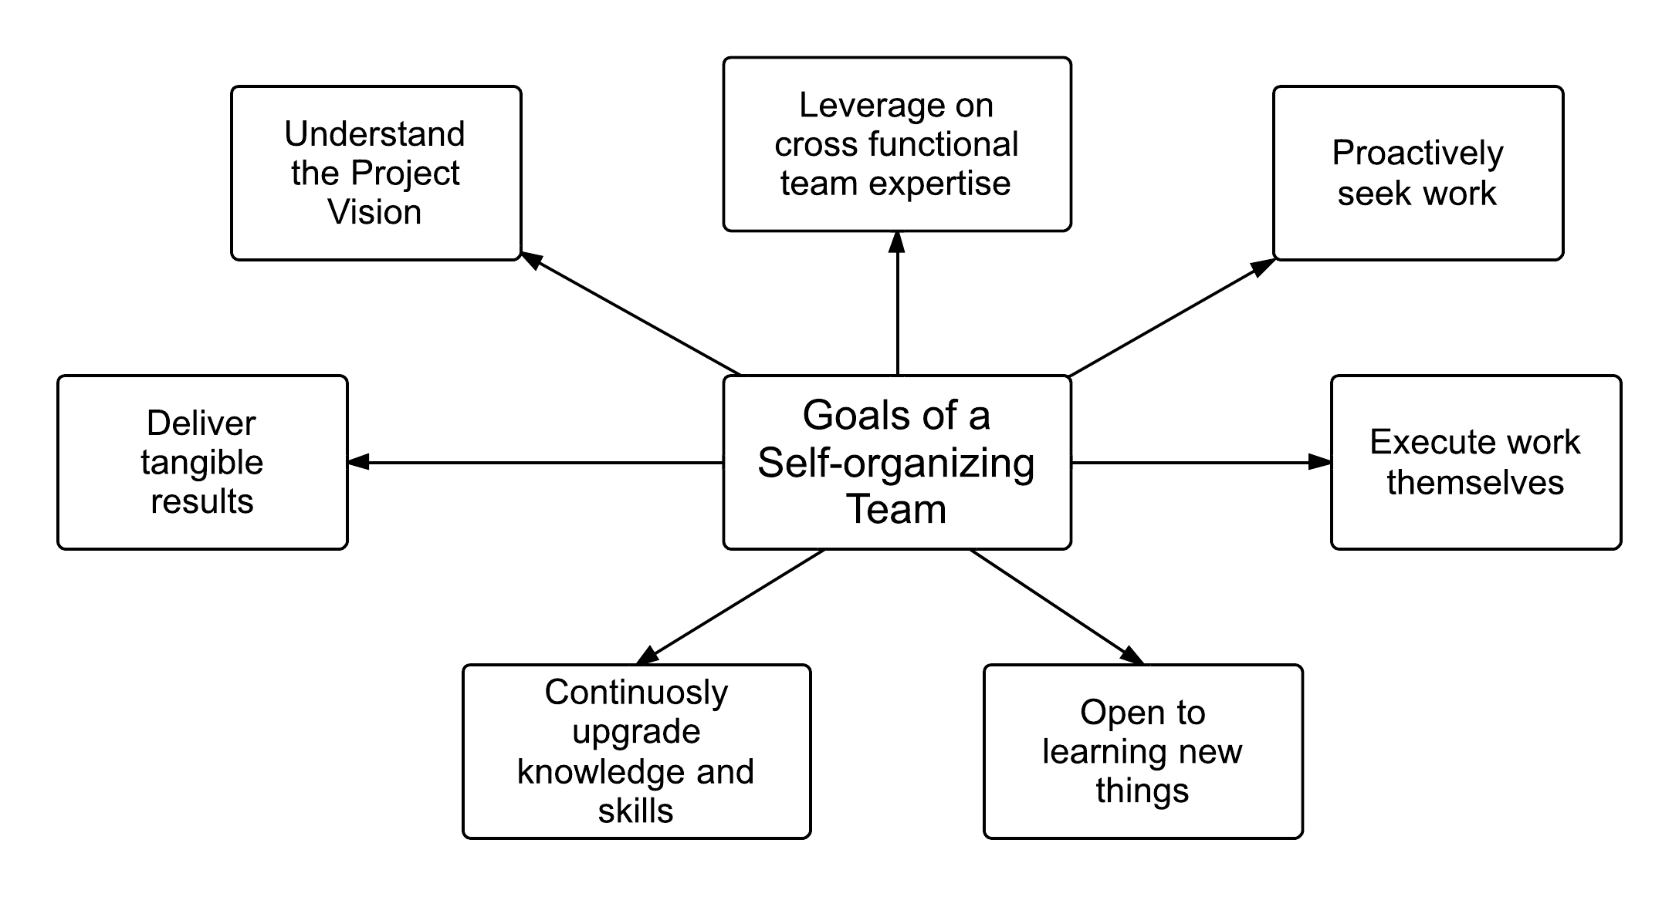
Self-organization - Goals of a Self-organizing Team
Fig 2-5: Goals of a Self-organizing Team; Page 28 SBOK™ Guide

Slide 128
Question
As a self-organizing Scrum Team, Team L manages the work they will carry out during the Sprints in their current project. Their Product Owner has confidence in Team L believing them to be fully motivated and, therefore adheres to a participative management style. According to the various management and leadership theories, which kind of a leader is the Product Owner?
A Theory Y leader
A Task-oriented leader
A Delegating leader
A Theory X leader

Slide 129
Answers Will be Provided by the Faculty

Slide 130
Question
Leonard is the Product Owner for a Scrum project to develop software for library management. He knows that he must facilitate the formation of a self-organizing team in order to achieve the goals of the project. Which of the following is NOT true of self-organizing teams in Scrum?
In a self-organizing Scrum Team, new team members can be added whenever the Scrum Team desires.
A self-organizing team can create tasks independently during the Create Tasks process.
The team can benefit from the expertise of cross-functional team members in carrying out the work of the project during the Create Deliverables process
Team members should have a clear understanding of the Project Vision and how the project will deliver value to the organization.

Slide 131
Answers Will be Provided by the Faculty

Slide 132
Question
What is self-organization?
It refers to emphasizing achieving results by focusing on the needs of the Scrum Team.
It refers to delivering maximum business value in a minimum time span.
It refers to prioritizing creation of high value deliverables over lower value deliverables
It refers to allowing all facets of Scrum process to be observed by everyone.

Slide 133
Answers Will be Provided by the Faculty

Slide 134
Question
Which of the following statements on Scrum framework is TRUE?
Focuses on detailed upfront project planning.
Allows teams to take ownership of tasks.
Enables delegation of authority from one level to another.
Emphasizes individual accountability rather than group accountability.

Slide 135
Answers Will be Provided by the Faculty

Slide 136
If you have any additional questions on this topic, please post it in the Question window.
Question
What are responsibilities of senior management of an organization in enabling project teams to evolve into self-organized teams? Please type your answer in the Question window.

Slide 137
Scrum Principles – Collaboration

Slide 138
Scrum Principles - Collaboration
Collaboration in Scrum refers to the Scrum Core Team working together and interfacing with the stakeholders to create and validate the deliverables of the project to meet the goals outlined in the Project Vision.

Slide 139

Scrum Principles - Collaboration
Cooperation
Occurs when the work product consists of the sum of the work efforts of various people on a team.
Collaboration
Occurs when a team works together to play off each other’s inputs to produce something greater.

Slide 140

Scrum Principles - Collaboration
Core Dimensions of Collaborative Work
Awareness: Individuals working together need to be aware of each other’s work.
Articulation: Collaborating individuals must partition work into units, divide the units among team members, and then after the work is done, reintegrate it.
Appropriation: Adapting technology to one’s own situation; the technology may be used in a manner completely different than expected by the designers.

Slide 141
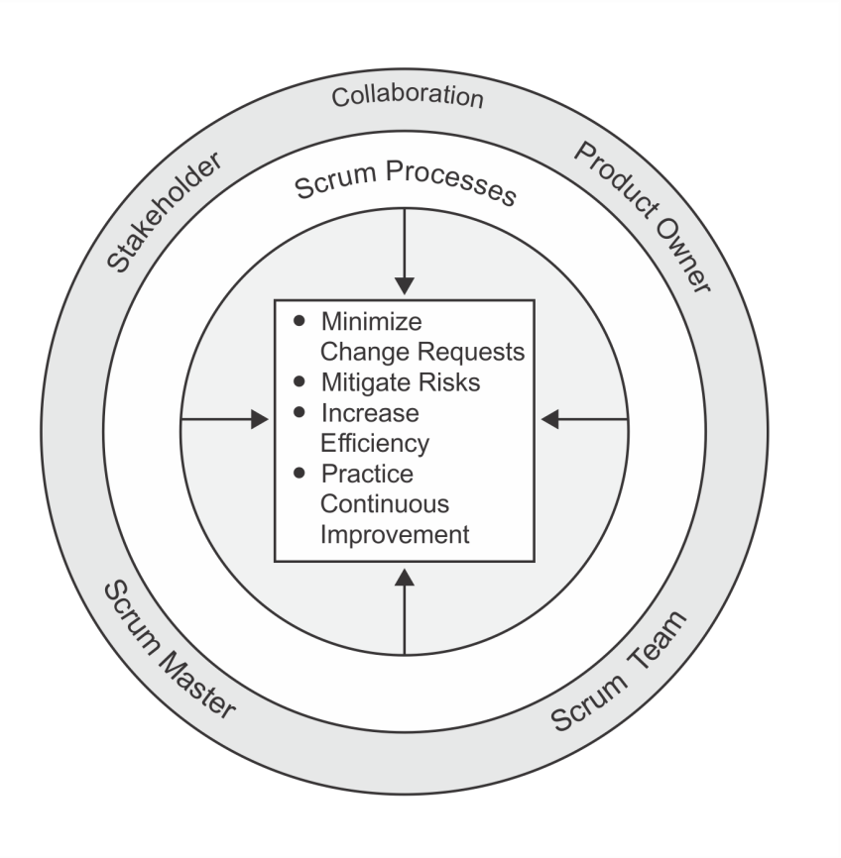
Benefits of Collaboration
Fig 2-6: Benefits of Collaboration in Scrum Projects; Page 30 SBOK™ Guide

Slide 142
Importance of Colocation in Collaboration
For many of the Scrum practices, high-bandwidth communication is required. To enable this, it is preferred that team members are colocated.
Colocation allows both formal and informal interaction between team members. This provides the advantage of having team members always at hand for coordination, problem-solving, and learning.

Slide 143

Scrum Principles - Collaboration
Key Benefits of Colocation
Questions get answered quickly
Problems are fixed on the spot
Less friction occurs between interactions
Trust is gained and awarded much more quickly

Slide 144
Question
The Scrum Core Team members collaborate with each other to deliver the maximum value to the customers. Which of the following is NOT true about collaboration in Scrum:
Collaboration minimizes the need for changes resulting from poorly clarified requirements
Risks are identified and dealt with efficiently.
It is possible to identify the low performer in any team.
Continuous improvement is ensured through the sharing of lessons learned.

Slide 145
Answers Will be Provided by the Faculty

Slide 146
Question
The Product Owner, being a part of the Scrum Core Team, must ensure that he/she collaborates with the other team members and the stakeholders throughout the project. Which of the following statements is true about the particular project benefits realized due to collaboration within Scrum?
Collaboration helps identify the need for change in the process.
Collaboration enables avoidance of risks.
Collaboration enables the team to manage issues more effectively.
Collaboration requires the exchange of tasks between the team members at regular intervals.

Slide 147
Answers Will be Provided by the Faculty

Slide 148
Question
Which of the following best defines collaboration?
It refers to individual Scrum Team members being aware of each other’s work.
It refers to the Scrum Core Team working together and interfacing with the stakeholders to create and validate the deliverables of the project to meet the stated goals.
It refers to achieving results by focusing on the needs of the Scrum Team.
It refers to proposes fixing a certain amount of time for each process and activity in a Scrum project.

Slide 149
Answers Will be Provided by the Faculty

Slide 150
Question
According to SBOK™, which of the following is NOT a core dimension of Collaboration?
Adaptation
Appropriation
Articulation
Awareness

Slide 151
Answers Will be Provided by the Faculty

Slide 152
If you have any additional questions on this topic, please post it in the Question window.
Question
How is work articulated within the teams of your projects? Please type your answer in the Question window.

Slide 153
Scrum Principles – Value-based Prioritization

Slide 154
Scrum Principles – Value-based Prioritization
VALUE
The Scrum framework is driven by the goal of delivering maximum business value in a minimum time span.
One of the most effective tools for delivering the greatest value in the shortest amount of time is prioritization.
Prioritization can be defined as determination of the order and separation of what must be done now, from what needs to be done later.

Slide 155
Scrum Principles – Value-based Prioritization
$$$
Scrum uses value-based prioritization as a core principle that drives the structure and functionality of the entire Scrum framework
Scrum aims at delivering a valuable product or service to the customer on an early and continuous basis
Prioritization is done by the Product Owner when he or she prioritizes User Stories in the Prioritized Product Backlog.

Slide 156
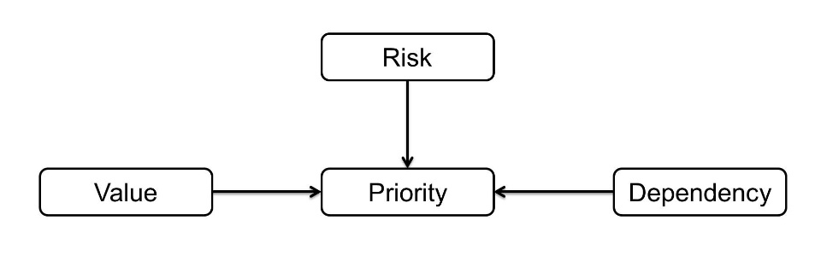
Scrum Principle – Value-based Prioritization
While prioritizing requirements in the Prioritized Product Backlog, the following three factors are considered:
Fig 2-7: Value-based Prioritization; Page 32 SBOK™ Guide

Slide 157
Question
Scrum uses value-based prioritization. Prioritization is done by the Product Owner when he/she prioritizes User Stories in the Prioritized Product Backlog. Which of the following statements is true about value-based prioritization?
The Product Owner works with the Scrum Team, to understand the project’s risks and uncertainty as they may have negative consequences associated with them.
The dependencies that the Scrum Team brings to the notice of the Product Owner do not need to be taken into account during prioritization.
Scrum never uses multiple task-prioritization techniques unlike the traditional Waterfall model of project management.
To deliver maximum business value in a minimum time span, the customer must be encouraged to mandate all User Stories to be of high priority.

Slide 158
Answers Will be Provided by the Faculty

Slide 159
Question
Which of the following is the first step in Value-based Prioritization?
Using a Prioritized Product Backlog for the development cycle.
Holding workshops to identify potential features of the project.
Determining broad-level vision, goals, and mission of the project.
Understanding what the customer wants and values in order to arrange the User Stories by relative importance.

Slide 160
Answers Will be Provided by the Faculty

Slide 161
Question
Which of the following statements on Value-based Prioritization is TRUE?
This principle describes how time is considered a limiting constraint in Scrum and is used to help effectively manage project planning and execution. Scrum elements impacted by this principle include Sprints, Daily Standup Meetings, Sprint Planning Meetings, and Sprint Review Meetings.
This principle focuses on today’s workers, who deliver significantly greater value when encouraged to self-organize rather than be subject to the command and control style of traditional project management.
This principle focuses on the three core dimensions related to collaborative work: awareness, articulation, and appropriation. It also advocates project management as a shared value-creation process with teams working and interacting together to deliver the greatest value.
This principle highlights the focus of Scrum to deliver maximum business value, beginning early in the project and continuing throughout.

Slide 162
Answers Will be Provided by the Faculty

Slide 163
Question
Which of the following Scrum aspects translate(s) the Scrum principle Value-based Prioritization into practice?
1. Business Justification.
2. Risk.
3. Change.
4. Organization.
1
1, 3 and 4
1, 2 and 3
1, 2, 3 and 4

Slide 164
Answers Will be Provided by the Faculty

Slide 165
If you have any additional questions on this topic, please post it in the Question window.
Question
Why do you think prioritization of requirements is important in a project? Please type your answer in the Question window.

Slide 166
Scrum Principles – Time-boxing

Slide 167

Scrum Principle - Time-boxing
Scrum treats time as one of the most important constraints in managing a project.
To address the constraint of time, Scrum introduces a concept called ‘Time-boxing’ which proposes fixing a certain amount of time for each process and activity in a Scrum project.
This ensures that Scrum Team members do not take up too much or too little work for a particular period of time and do not expend their time and energy on work for which they have little clarity.
Time-boxing is useful in avoiding excessive improvement or gold-plating of an item.

Slide 168
Scrum Principle - Time-boxing
Advantages of Time-boxing:
Efficient development process
Less overheads
High velocity for teams

Slide 169
Question
Terson Technologies is working on a month-long software development project for an airline company. Time-boxing is an important Scrum principle. Which of the following pairs has been incorrectly Time-boxed according to general Scrum practice?
Daily Standup: 15 minutes
Retrospect Sprint Meeting: 8 hours
Sprint Planning Meeting: 8 hours
Sprint Review Meeting: 4 hours

Slide 170
Answers Will be Provided by the Faculty

Slide 171
Question
Which of the following is NOT an advantage of Time-boxing in Scrum projects?
Time-boxing helps motivate the team to enhance performance.
Time-boxing provides structure to Scrum projects.
Time-boxing helps teams evaluate and undergo necessary training
Time-boxing provides an element of certainty in Scrum projects, which are often volatile and dynamic in nature

Slide 172
Answers Will be Provided by the Faculty

Slide 173
Question
Which of the following statements on Time-boxing is INCORRECT?
It proposes fixing certain timeframe for each activity.
It ensures that Scrum Team members do not take up too much or too little work for a particular period of time.
It is a principle through which Scrum framework addresses the project constraint of ‘time’.
It ensures that there is detailed upfront planning before every Sprint begins.

Slide 174
Answers Will be Provided by the Faculty

Slide 175
Question
Which of the following statements best describes Time-boxing?
This principle describes how time is considered a limiting constraint in Scrum, and used to help effectively manage project planning and execution. The elements in Scrum subject to this principle include Sprints, Daily Standup Meetings, Sprint Planning Meetings, and Sprint Review Meetings
This principle highlights the focus of Scrum to deliver maximum business value, beginning early in the project and continuing throughout.
This principle focuses on today’s workers, who deliver significantly greater value when encouraged to self-organize rather than be subject to the command and control style of traditional project management.
This principle focuses on the three core dimensions related to collaborative work: awareness, articulation, and appropriation. It also advocates project management as a shared value-creation process with teams working and interacting together to deliver the greatest value.

Slide 176
Answers Will be Provided by the Faculty

Slide 177
If you have any additional questions on this topic, please post it in the Question window.
Question
Are there any negative consequences of using the concept ‘time-boxing’? Please type your answer in the Question window.

Slide 178
Scrum Principles – Iterative Development

Slide 179
Scrum Principle - Iterative Development
In most complex projects, the customer may not be able to define very concrete requirements or is not confident of what the end product may look like.
The iterative model is more flexible in ensuring that any change requested by the customer can be included as part of the project.
VALUE

Slide 180
Iterative Development - Benefits
The benefit of iterative development is that it allows for course correction as all the people involved get better understanding of what needs to be delivered as part of the project and incorporate these learning in an iterative manner.
Thus, the time and effort required to reach the final end point is greatly reduced and the team produces deliverables that are better suited to the final business environment.

Slide 181
Question
For an Agile team, which of the following concepts regarding iterative development should it be aware of?
The designing, developing, and testing of feature code should be done once in the beginning.
All changes should be addressed to at the end of the development phase.
There is room to accommodate changes.
Simplification of the development process is not a priority.

Slide 182
Answers Will be Provided by the Faculty

Slide 183
Question
Which of the following statements best describes Iterative Development?
This principle highlights the focus of Scrum to deliver maximum business value, from beginning early in the project and continuing throughout.
This principle defines and emphasizes how to better manage changes and build products that satisfy customer needs. It also delineates the Product Owner’s and organization’s responsibilities related to developing deliverables and products.
This principle describes how time is considered a limiting constraint in Scrum, and used to help effectively manage project planning and execution. Time-boxed elements in Scrum include Sprints, Daily Standup Meetings, Sprint Planning Meetings, Sprint Review Meetings.
This principle focuses on the three core dimensions related to collaborative work: awareness, articulation, and appropriation. It also advocates project management as a shared value-creation process with teams working and interacting together to deliver the greatest value.

Slide 184
Answers Will be Provided by the Faculty

Slide 185
Question
What is iterative development?
It refers to using more than one product development cycle to develop the final project deliverables through the learning from the previous development cycles.
It refers to developing the final project deliverables in one product development cycle.
It refers to developing project deliverables using automated processes.
It refers to developing project outputs through detailed upfront planning with emphasis on fixing scope, quality and other project aspects.

Slide 186
Answers Will be Provided by the Faculty

Slide 187
Question
Which of the following statements on ensuring flexibility in Scrum is INCORRECT?
Scrum ensures stability by providing scope for detailed planning at the beginning of every Sprint.
Scrum uses iterative delivery and its other characteristics and principles to achieve balance between flexibility and stability.
Scrum maintains flexibility by making it possible to incorporate change at any step in the development process in a Scrum project.
Scrum ensures flexibility by providing scope for the Scrum Core Teams to make recommendations for changes.

Slide 188
Answers Will be Provided by the Faculty

Slide 189
If you have any additional questions on this topic, please post it in the Question window.
Question
What do you think should ideally happen to project timelines when iterative delivery is used if all the other aspects like scope, quality, etc. remain unchanged? Please type your answer in the Question window.

Slide 190
Scrum Aspects

Slide 191
Scrum Aspects
Organization
Business Justification
Quality
Change
Risk

Slide 192
Scrum Aspects - Organization

Slide 193
Scrum Aspects – Organization
Understanding defined roles and responsibilities in a Scrum project is very important for ensuring the successful implementation of Scrum.
Scrum roles fall into two broad categories:
Core Roles
Non-core Roles

Slide 194
Organization - Core Roles
Core roles are those roles which are mandatorily required for producing the product of the project, are committed to the project, and ultimately are responsible for the success of each Sprint of the project and of the project as a whole.
There are three core roles in Scrum that are ultimately responsible for meeting the project objectives. The core roles are:
Product Owner,
Scrum Master
Scrum Team.
Together they are referred to as the Scrum Core Team.
It is important to note that, of these three roles, no role has authority over the others.

Slide 195
Organization - Core Roles
Product Owner
Scrum Master
Scrum Team

Slide 196
Core Roles – Product Owner

Slide 197
Core Roles – Product Owner
Represents the stakeholders and is responsible for ensuring that the Scrum Team delivers value.
Writes the business requirements in the form of User Stories with input from Scrum Core Team members and manages the Prioritized Product Backlog.
In some cases, Scrum Team members may write User Stories under the supervision of the Product Owner.
Responsible for ensuring clear communication of product functionalities to the Scrum Team and, therefore, is commonly called the Voice of Customer.

Slide 198
Core Roles – Scrum Master

Slide 199
Core Roles – Scrum Master
The Scrum Master is the “servant leader” of the Scrum Team who moderates and facilitates team interactions as team coach and motivator.
The Scrum Master is responsible for ensuring that the team has a productive work environment by guarding the team from external influences, removing any obstacles, and enforcing Scrum principles, aspects, and processes.

Slide 200
Servant Leadership - Traits
Scrum believes that all leaders of Scrum projects (including the Scrum Master and Product Owner) should be servant-leaders who have the following traits:
Listening
Empathy
Healing
Awareness
Persuasion
Conceptualization
Foresight
Stewardship
Commitment to the growth of others
Building community

Slide 201
Popular HR Theories – Theory X and Theory Y
Douglas McGregor (1960) proposed two management theories:
Theory X—Theory X leaders assume employees are inherently unmotivated and will avoid work if possible, warranting an authoritarian style of management.
Theory Y—Theory Y leaders, on the other hand, assume employees are self-motivated and seek to accept greater responsibility. Theory Y involves a more participative management style.
All leaders in Scrum projects should subscribe to Theory Y, whereby they view individuals as important assets and work towards developing their team members' skills and empowering their team members while expressing appreciation for the work the team has completed to accomplish the project objectives.

Slide 202

Core Roles – Scrum Team

Slide 203
Core Roles – Scrum Team
The Scrum Team is sometimes referred to as the Development Team since they are responsible for developing the product, service, or other result.
It consists of a group of 6-10 individuals who work on the User Stories in the Sprint Backlog to create the Deliverables for the project.

Slide 204
Scrum Team – Team Selection
Scrum Team members should be generalist-specialists.
Beyond the subject-matter expertise, it is the soft skills of team members that determine the success of self-organizing teams.)
Ideal members of the Scrum Team are independent, self-motivated, customer-focused, responsible, and collaborative.
The team should be able to foster an environment of independent thinking and group decision-making to extract the most benefits from the structure.
When selecting teams, another important aspect is to create backups for every person.
This ensures that there is no major loss of productivity due to losses of critical members.
Every member of the team will back up a “specialist” member, which enhances the skill sets of team members.

Slide 205
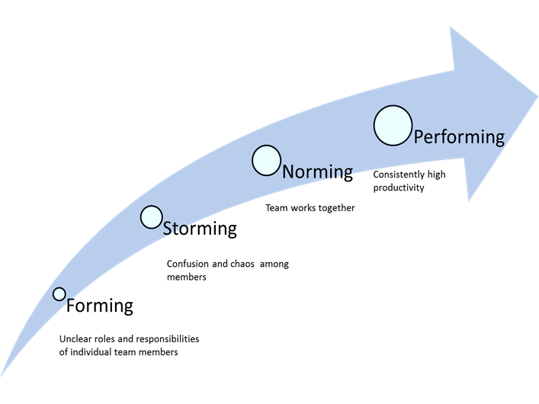
Popular HR Theories - Tuckman’s Model of Group Dynamics
Figure 3‑5: Tuckman’s Stages of Group Development; SBOK Page 57

Slide 206
Popular HR Theories - Tuckman’s Model of Group Dynamics
The four stages of the model are the following:
Forming—This is often experienced as a fun stage because everything is new and the team has not yet encountered any difficulties with the project.
Storming—During this stage, the team tries to accomplish the work; however, power struggles may occur, and there is often chaos or confusion among team members.
Norming—This is when the team begins to mature, sort out their internal differences, and find solutions to work together. It is considered a period of adjustment.
Performing—During this stage, the team becomes its most cohesive, and it operates at its highest level in terms of performance. The members have evolved into an efficient team of peer professionals who are consistently productive.

Slide 207
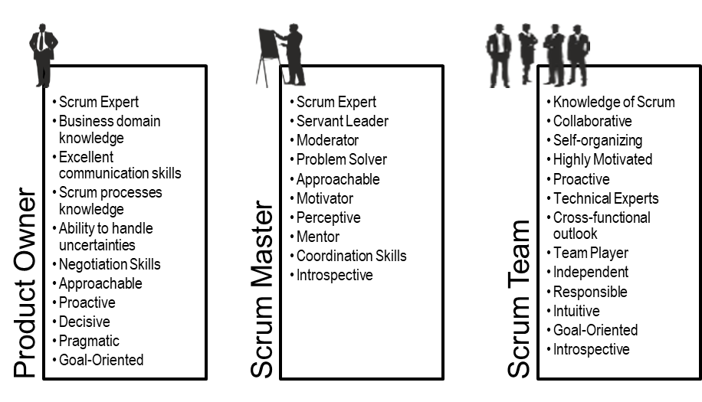
Personnel Selection
Figure 3‑3: Desirable Traits for the Core Scrum Roles; SBOK Page 51

Slide 208
Organization - Non-core Roles

Slide 209
Organization - Non-core Roles
Non-core roles are those roles which are not mandatorily required for the Scrum project and may include team members who are interested in the project.
They have no formal role in the project team and may interface with the team, but may not be responsible for the success of the project.

Slide 210
Non-core Roles – Key Stakeholders
A collective term that includes customers, users, and sponsors, who frequently interface with the Scrum Core Team to provide them with inputs and to facilitate creation of the project’s product, service, or other result.
Stakeholders influence the project throughout the project’s development.
Most importantly, it is for the stakeholders that the project produces the collaborative benefits.

Slide 211
Non-core Roles – Key Stakeholders
Customer: The customer is the individual or the organization that acquires the project’s product, service, or other result. For any organization, depending on the project, there can be both internal customers (i.e., within the same organization) or external customers (i.e., outside of the organization).
Users - Users are the individual or the organization that directly uses the project’s product, service, or other result. Like customers, for any organization, there can be both internal and external users. Also, in some industries customers and users may be the same.
Sponsor - The sponsor is the individual or the organization that provides resources and support for the project. The sponsor is also the stakeholder to whom everyone is accountable in the end.
At times, the same person or organization can play multiple stakeholder roles; for example, the sponsor and the customer may be the same.

Slide 212
Non-core Roles – Scrum Guidance Body
The Scrum Guidance Body (SGB) is an optional role but highly recommended to formalize organizational practices related to Scrum.
It generally consists of a group of documents and/or a group of experts who are typically involved with defining objectives related to quality, government regulations, security, and other key organizational parameters.
The Scrum Guidance Body also helps capture the best practices that should be used across all Scrum projects in the organization.
The Scrum Guidance Body does not make decisions related to the project.
SGB acts as a consulting or guidance structure for all the hierarchy levels in the project organization—the portfolio, program, and project.
Scrum Teams have the option of asking the Scrum Guidance Body for advice as required.

Slide 213
Question
Though the overall success of a Scrum project lies with the entire team, it is the Product Owner who holds primary responsibility for business justification. Listed below are certain responsibilities that contribute towards the project’s success. Of the following, which is a responsibility of the Product Owner?
Provides transparent work environment for Scrum Teams
Coordinates with and facilitates the Scrum Team to create deliverables
Provides legal guidelines related to business justification techniques for the Scrum Core Team to follow
Prioritizes business value to the organization, which is achieved by creating the Prioritized Product Backlog

Slide 214
Answers Will be Provided by the Faculty

Slide 215
Question
Many of the Scrum Master’s duties and responsibilities require him/her to work in close coordination with the Product Owner. Which of the following is NOT a responsibility shouldered by both the Scrum Master and the Product Owner?
Identify the Stakeholders for the project
Help Scrum Team in creating the Sprint Backlog
Create the Scrum Team and develop the Team Building Plan
Ensure an ideal project environment for the Scrum Team in the succeeding Sprints

Slide 216
Answers Will be Provided by the Faculty

Slide 217
Question
ABC, Inc. wants to implement Scrum for a mobile app development project. One of the prioritized User Stories is related to the creation of a payment gateway and its Acceptance Criteria have been defined by the Product Owner. Which of the following statements is NOT true?
Based on his understanding of the customer requirements, the Product Owner develops the Acceptance Criteria.
A detailed communication of the prioritized User Story to the Scrum Team is carried out by the Scrum Master.
When communicating the User Story to the Scrum Team, the agreement of the Scrum Team is sought.
If the Product Owner accepts the deliverables, then the User Story is considered Done.

Slide 218
Answers Will be Provided by the Faculty

Slide 219
Question
A software company is initiating a new project. A User Story Workshop is being held to help the Product Owner prioritize requirements. Who among the following facilitates User Group Meetings?
Product Owner
Scrum Team
Executive Sponsor
Scrum Master

Slide 220
Answers Will be Provided by the Faculty

Slide 221
If you have any additional questions on this topic, please post it in the Question window.
Question
What are few of the personality traits that the senior management can look for when identifying individuals to the roles of Product Owner and Scrum Master? Please type your answer in the Question window.

Slide 222
If you have any additional questions on this topic, please post it in the Question window.
Question
Can a Product Owner work on multiple projects simultaneously? Please type your answer in the Question window.

Slide 223
Scrum Aspects - Business Justification

Slide 224
Scrum Aspects - Business Justification
It is important for an organization to perform a proper business assessment prior to starting any project.
This helps key decision makers understand the business need for a change or for a new product or service, the justification for moving forward with a project, and its viability.
Since value is a primary reason for any organization to move forward with a project, Value-driven Delivery must be the main focus.
Scrum facilitates delivery of value very early on in the project and continues to do so throughout the project lifecycle.

Slide 225
Business Justification – Value-driven Delivery
Business justification in Scrum is based on the concept of Value-driven Delivery.
One of the key characteristics of any project is the uncertainty of results or outcomes.
It is impossible to guarantee project success at completion, irrespective of the size or complexity of a project.
Considering this uncertainty of achieving success, Scrum attempts to start delivering results as early in the project as possible.
This early delivery of results, and thereby value, provides an opportunity for reinvestment and proves the worth of the project to interested stakeholders.

Slide 226
Business Justification – Value-driven Delivery
In order to provide Value-driven Delivery, it is important to:
Understand what adds value to customers and users and to prioritize the high value requirements on the top of the Prioritized Product Backlog.
Decrease uncertainty and constantly address risks that can potentially decrease value if they materialize.
Work closely with project stakeholders showing them product increments at the end of each Sprint, enabling effective management of changes.
Create Deliverables based on the priorities determined by producing potentially shippable product increments during each Sprint so that customers start realizing value early on in the project.

Slide 227
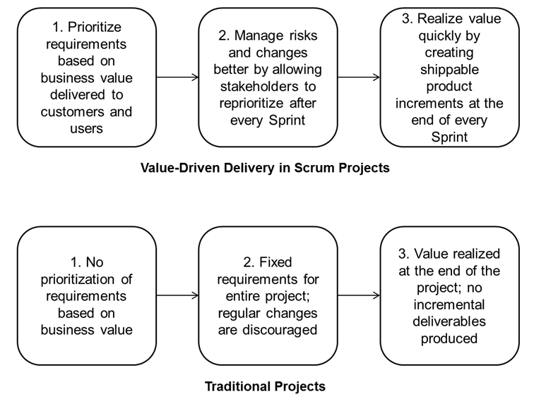
Value-driven Delivery in Scrum versus Traditional Projects
Fig 4-1: Delivering Value in Scrum vs. Traditional Projects; Page 67 SBOK™ Guide

Slide 228
Business Justification and its Content
Contents of a Business Case
Project reasons
Business options
Costs
Timescales
Major risks
Expected benefits
Expected dis-benefits or negative consequences
Investment appraisal

Slide 229
Question
You are a Product Owner for a project and have to provide business justification for undertaking the project. Which of the following factors can be considered important for business justification?
A. Business needs, or those business outcomes that the project is expected to fulfill, as documented in the Project Vision Statement
B. The opportunity cost, including basic information on the next best business option that was rejected in favor of the option selected
C. The timescales that reflect the duration of a project and the time over which its benefits will be realized
D. The project costs, including investments and other development costs to produce the project deliverables
Only A
Only B and C
Only A and D
A, B, C and D

Slide 230
Answers Will be Provided by the Faculty

Slide 231
Question
Though the overall success of a Scrum project lies with the entire team, it is the Product Owner who holds primary responsibility for business justification. Listed below are certain responsibilities that contribute towards the project’s success. Of the following, which is a responsibility of the Product Owner?
Funds the project
Coordinates with and facilitates the Scrum Team to create deliverables
Provides legal guidelines related to business justification techniques for the Scrum Core Team to follow
Prioritizes and delivers business value to the organization through the Prioritized Product Backlog

Slide 232
Answers Will be Provided by the Faculty

Slide 233
Question
Which of the following statements is not true with regard to the Scrum framework?
User requirements are prioritized based on their business value
The Product Owner should follow a change control procedure to make any changes to the Prioritized Backlog Items in the Prioritized Product Backlog
Business value is delivered incrementally
Deliverables are created on the basis of the business value they provide.

Slide 234
Answers Will be Provided by the Faculty

Slide 235
Question
Who among the following is responsible for assessing the business justification?
Product Owner
Scrum Team
Sponsors
Stakeholders

Slide 236
Answers Will be Provided by the Faculty

Slide 237

Scenario
VMfoods is a 10-year-old, nationwide grocery chain with about 100 outlets. Lately, the management team at VMfoods has observed that their customers are leading a fast-paced lifestyle and do not travel long distances to do their grocery shopping. They also feel that because grocery shopping is not a highly involved process (and because VMfoods always provides high-quality products), the best way to increase market share would be to deliver groceries to the customer’s residence.
The management team has asked VP, Sales to provide options that the organization can pursue to deliver groceries to customers’ residences. They need the solution to be implemented within three months without spending anything above $150,000. The VP has assessed multiple options including creating a new website, carrying out a door to door campaign, posting Ads in local newspapers and websites, and opening new stores in well populated suburbs. If any of the options are not pursued soon there is a chance that the organization may further lose its market share to new competitors.
Based on the above scenario, create a Business Case.

Slide 238
If you have any additional questions on this topic, please post it in the Question window.
Question
You have spent 50% of your project budget and then your assessment shows that the project no longer has a business justification. What should you do in such a case? Please type your answer in the Question window.

Slide 239
Scrum Aspects - Quality

Slide 240
Scrum Aspects - Quality
Quality is defined as the ability of the completed product or deliverables to meet the Acceptance Criteria (objective components by which a User Story’s functionality is judged) and achieve the business value expected by the customer
To ensure that a project meets quality requirements, Scrum adopts an approach of continuous improvement whereby the team learns from experience and stakeholder engagement to constantly keep the Prioritized Product Backlog updated with any changes in requirements.
The Prioritized Product Backlog is simply never complete until the closure or termination of the project.
Since Scrum requires work to be completed in increments during Sprints, this means that errors or defects get noticed earlier through repetitive quality testing, rather than when the final product or service is near completion.

Slide 241
Scrum Aspects - Quality
Important quality-related tasks (e.g., development, testing, and documentation) are completed as part of the same Sprint by the same team—this ensures that quality is inherent in any Done deliverable created as part of a Sprint.
Quality management will include quality planning, quality control, and quality assurance activities.
Constant discussions between the Scrum Core Team and stakeholders with actual increments of the product being delivered at the end of every Sprint, ensures that the gap between customer expectations from the project and actual deliverables produced is constantly reduced.

Slide 242
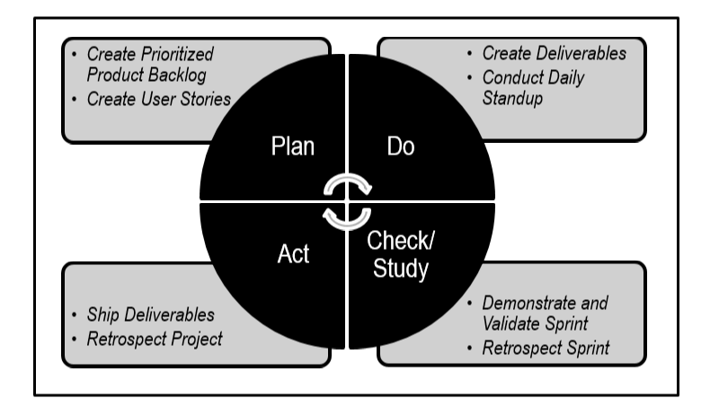
Quality - Plan-Do-Check-Act (PDCA) Cycle
Fig 5-3: PDCA Cycle in Scrum; Page 93 SBOK™ Guide

Slide 243
Question
Quality in Scrum means both customer satisfaction and a working product. To ensure quality, the Product Owner must not only clarify customer requirements to the Scrum Team, but must also keep the customer updated regarding any quality related concerns or issues early in the project. As a Product Owner, identify which of the following is NOT a component of quality management in Scrum:
Quality Planning
Quality Control
Quality Assurance
Quality Audit

Slide 244
Answers Will be Provided by the Faculty

Slide 245
Question
The quality of a project is captured in the Prioritized Product Backlog. It is the Product Owner who has to present requirements in the Prioritized Product Backlog. Which of the following statements is true about the Prioritized Product Backlog?
Partially completed User Stories can be accepted as Done, and then they can be moved back into the Prioritized Product Backlog for further completion.
The product components that have defects can never be incorporated as Prioritized Product Backlog Items.
User Stories in the Prioritized Product Backlog that fulfill most, but not all, Acceptance Criteria can be accepted as Done.
The Product Owner can solely decide to accept or reject whether a particular User Story in a Prioritized Product Backlog is Done according to the agreed upon Acceptance Criteria.

Slide 246
Answers Will be Provided by the Faculty

Slide 247
Question
Which of the following is the objective component by which a User Story’s functionality is judged?
Customer Quality Expectations
Acceptance Criteria
Epics
User Needs

Slide 248
Answers Will be Provided by the Faculty

Slide 249
Question
When will a Product Owner accept a deliverable?
After verifying the deliverables with the acceptance criteria
After developing acceptance criteria
After Prioritized Product Backlog is updated
None of the above

Slide 250
Answers Will be Provided by the Faculty

Slide 251
If you have any additional questions on this topic, please post it in the Question window.
Question
What is the difference between scope and quality? Please type your answer in the Question window.

Slide 252
Scrum Aspects - Change

Slide 253

Scrum Aspects - Change
Every project, regardless of its method or framework used, is exposed to change.
It is imperative that project team members understand that the Scrum development processes are designed to embrace change.
Organizations should try to maximize the benefits that arise from change and minimize any negative impacts through diligent change management processes in accordance with the principles of Scrum.

Slide 254
Scrum Aspects - Change
A primary principle of Scrum is its acknowledgement that:
stakeholders change their mind about what they want and need throughout a project (sometimes referred to as “requirements churn”)
it is very difficult, if not impossible, for stakeholders to define all requirements during project initiation.
Scrum projects welcome change by using short, iterative Sprints that incorporate customer feedback on each Sprint’s deliverables.
This enables the customer to regularly interact with the Scrum Team members, view deliverables as they are ready, and change requirements if needed earlier in the Sprint.

Slide 255
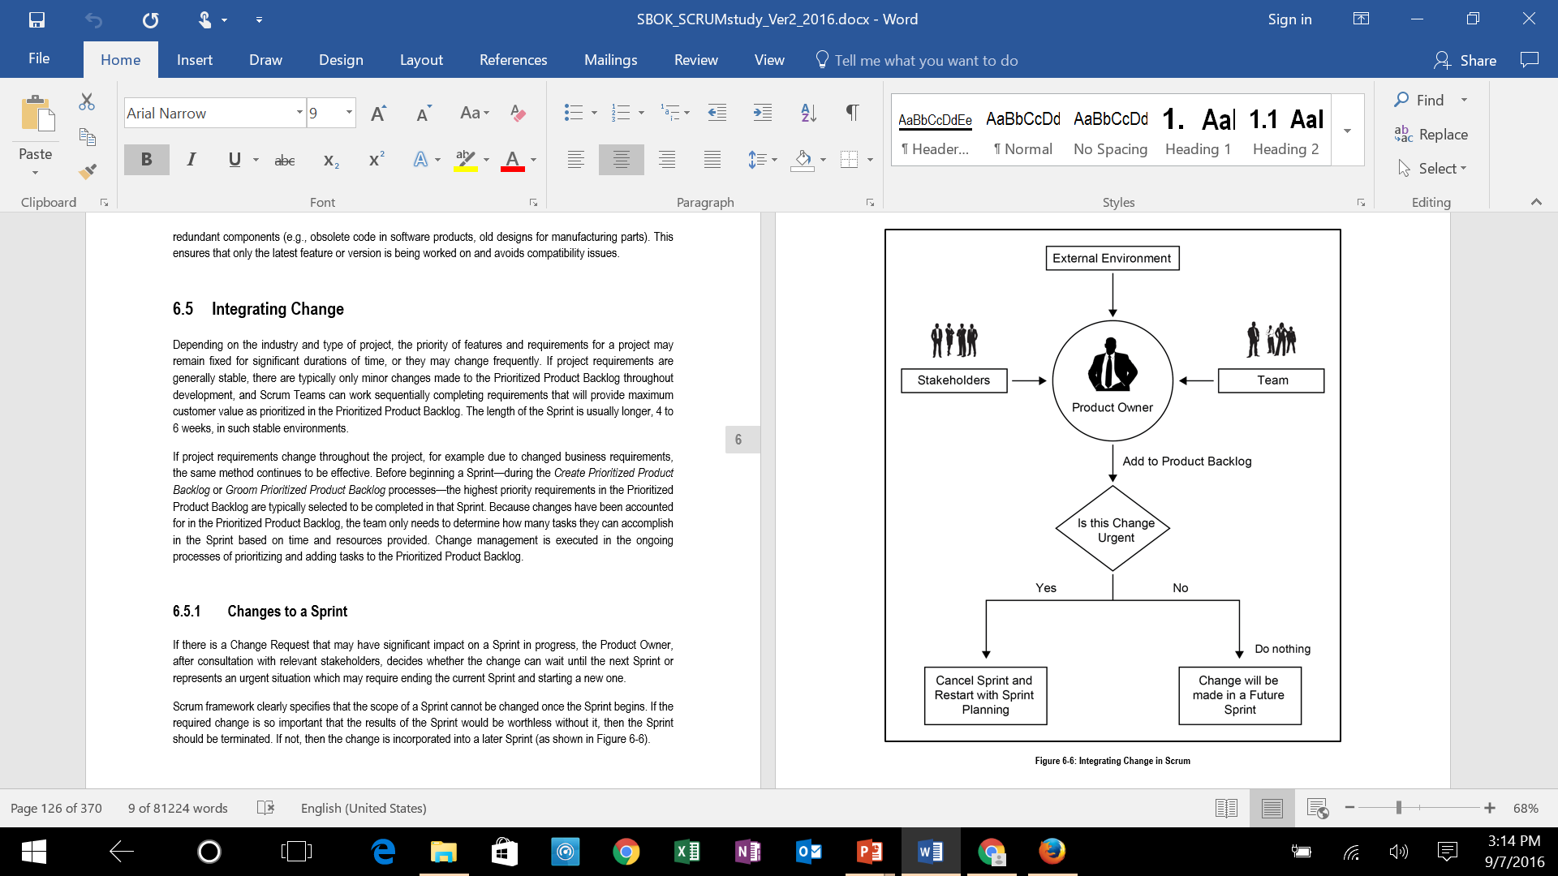
Integrating Change - Changes to a Sprint
?
Figure 6-6: Integrating Change in Scrum; Page 107 SBOK™ Guide

Slide 256
Question
The Product Owner plays a very important role in managing changes in a Scrum Project. In this context which of the following is true?
Small changes that do not have significant impact on the project do not need any approval.
In most projects, 90% of Change Requests are beyond the tolerance level of the Product Owner.
Change Requests for the project are discussed and approved during Create Deliverables process.
Change Requests can be created and approved at any time during the project.

Slide 257
Answers Will be Provided by the Faculty

Slide 258
Question
Which principle in Scrum helps to manage changes and build products that satisfy customer needs?
Time-Boxing
Iterative Development
Value-based Prioritization
Self-organization

Slide 259
Answers Will be Provided by the Faculty

Slide 260
Question
Who is responsible for ensuring that requirements and User Stories pertaining to an agreed Sprint are not changed?
Scrum Team
Product Owner
Scrum Master
Sponsor

Slide 261
Answers Will be Provided by the Faculty

Slide 262
Question
Which of the following statements on integrating change requests in Prioritized Product Backlog is INCORRECT?
If project requirements are generally stable, there are typically only minor changes made to the Prioritized Product Backlog throughout development.
Before beginning a Sprint during the Create Prioritized Product Backlog or Groom Prioritized Product Backlog processes the highest priority requirements in the Prioritized Product Backlog are typically selected to be completed in that Sprint.
Change management is executed in the ongoing processes of prioritizing and adding tasks to the Prioritized Product Backlog.
None of the above

Slide 263
Answers Will be Provided by the Faculty

Slide 264
If you have any additional questions on this topic, please post it in the Question window.
Question
​If you are using Scrum, is your Product Owner empowered to make business decisions? Please type your answer in the Question window.

Slide 265
Scrum Aspects - Risk

Slide 266

Scrum Aspects - Risk
Risk is defined as an uncertain event or set of events that can affect the objectives of a project and may contribute to its success or failure.

Slide 267
Scrum Aspects - Risk
Positive impact
Opportunities
Negative impact
Threats

Slide 268
Scrum Aspects - Risk
Risks should be identified, assessed, and responded to based primarily on two factors:
the probability of an occurrence
the probable impact in the event of the occurrence
Risks with high probability and high impact rating should be addressed before those with a lower rating.
Once a risk is identified, it is important to understand the basic aspects of the risk with regard to the possible causes, the area of uncertainty, and the potential impact if the risk occurs.

Slide 269
Difference between Risks and Issues
Risks are future uncertainties and have no current impact on the project, but could have a potential impact on the future.
Issues are generally well-defined certainties that are currently happening on the project: so there is no need for conducting a probability assessment as we would for a risk. Issues must be dealt with.
Risks, if not addressed in time, may become issues.
The goal of risk management is to be prepared, with plans in place to deal with any risks that may occur.

Slide 270
Difference between Risks and Issues
Examples of risks:
Even after extensive training, the customer service representatives might not be ready to take orders on the go-live date.
The painting crew might be delayed due to heavy rain, which could negatively impact the project schedule.
Examples of issues:
Funding is not approved.
Requirements are unclear.

Slide 271
Risk Management Procedure
Assess
Prioritize
Mitigate
Identify
Communicate

Slide 272
Question
The purpose of creating a risk-adjusted backlog is to:
Determine whether it is viable to undertake the project.
Determine the sequence in which the risks will be eliminated.
Have a single list of tasks that need to be completed.
Remind the team that risks will always be part of any project.

Slide 273
Answers Will be Provided by the Faculty

Slide 274
Question
What are the two categories of risk?
Issues and Threats
Issues and Problems
Change and Opportunities
Threats and Opportunities

Slide 275
Answers Will be Provided by the Faculty

Slide 276
Question
Risks should be identified, assessed, and responded to based on which factors?
Possibility and Impact
Probability and Impact
Change and Impact
Probability and Severity

Slide 277
Answers Will be Provided by the Faculty

Slide 278
Question
Which of the following cannot be identified as a risk for a given project?
Funding for the project may not be made available in time for project completion without going beyond the agreed schedule.
The requirements given by the Product Owner are unclear to the development team.
The development team may not possess the required skills to develop the project’s products.
The Product Owner believes that the User Stories for product A may not accurately reflect the needs of the end users.

Slide 279
Answers Will be Provided by the Faculty

Slide 280
If you have any additional questions on this topic, please post it in the Question window.
Question
In your projects, is risk management carried out by specialist teams or project delivery teams? Please type your answer in the Question window.

Slide 281

Scrum Phases and Processes

Slide 282
Scrum Phases and Processes
Chapter | Phase | Fundamental Scrum Processes
8 | Initiate | Create Project Vision Identify Scrum Master and Stakeholder(s) Form Scrum Team Develop Epic(s) Create Prioritized Product Backlog Conduct Release Planning
9 | Plan and Estimate | Create User Stories Estimate User Stories Commit User Stories Identify Tasks Estimate Tasks Create Sprint Backlog
10 | Implement | Create Deliverables Conduct Daily Standup Groom Prioritized Product Backlog
11 | Review and Retrospect | Demonstrate and Validate Sprint Retrospect Sprint
12 | Release | Ship Deliverables Retrospect Project
Table 1‑1: Summary of Fundamental Scrum Processes; Page 15 SBOK™ Guide

Slide 283
Scrum Flow
Release Planning Meeting
Daily
Create Deliverables
Daily Standup
Meeting
Release Schedule
Sprint
1-6 weeks
Project Business Case | Project Vision Statement | Prioritized Product Backlog | Sprint Backlog | Accepted Deliverables
Project Vision Meeting
Sprint Planning Meeting
Sprint Review Meeting
Retrospect Spring Meeting

Slide 284
Scrum Phase - Initiate

Slide 285
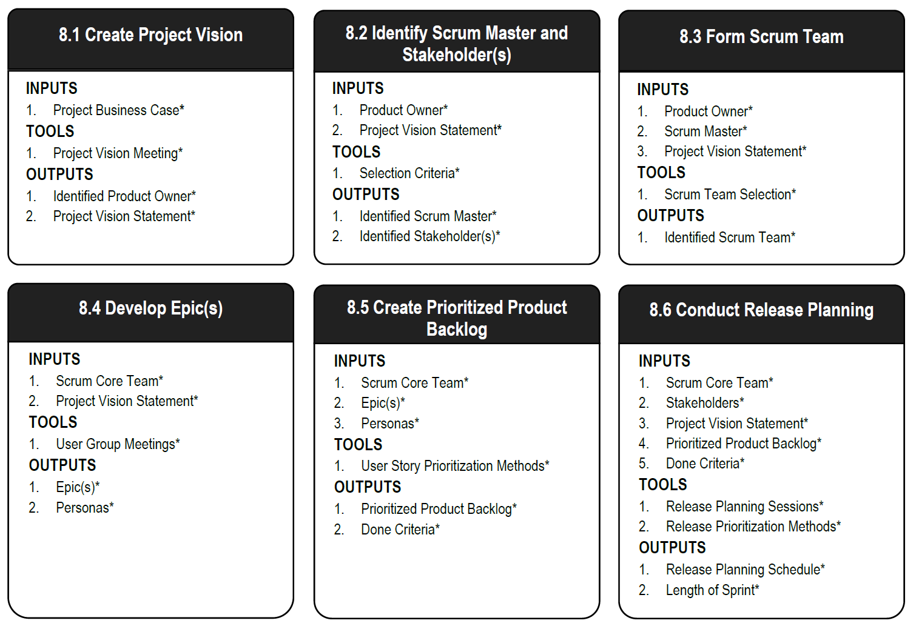
Scrum Phase - Initiate
Figure 8‑2: Initiate Overview (Essentials); SBOK Page 138

Slide 286
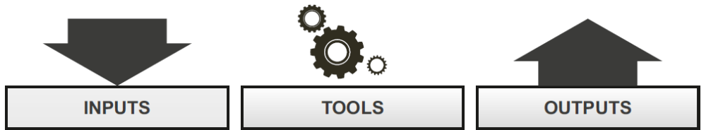
Initiate – Create Project Vision
Project Business Case*
Program Product Owner
Program Scrum Master
Program Stakeholder(s)
Program Product Backlog
Trial Project
Proof of Concept
Company Vision
Company Mission
Market Study
Scrum Guidance Body Recommendations
Project Vision Meeting*
JAD Sessions
SWOT Analysis
Gap Analysis
Identified Product Owner*
Project Vision Statement*
Project Charter
Project Budget
Figure 8‑3: Create Project Vision—Inputs, Tools, and Outputs; SBOK Page 139

Slide 287
Create Project Vision: Mandatory Tool – Project Vision Meeting
A Project Vision Meeting is a meeting with the Product Owner, the Sponsor and other Project Stakeholder(s).
It helps identify the business context, business requirements, and stakeholder expectations in order to develop an effective Project Vision Statement.
Scrum believes in closely engaging and collaborating with all business representatives to get their buy-in for the project and to deliver greater value

Slide 288
Create Project Vision: Critical Output –
Identified Product Owner
The Product Owner is the person responsible for achieving maximum business value for the project.
He or she is also responsible for articulating customer requirements and maintaining business justification for the project.
The Product Owner represents the Voice of the Customer.

Slide 289
Create Project Vision: Critical Output –
Project Vision Statement
A good project vision explains the business need the project is intended to meet rather than how it will meet the need.
The Project Vision Statement should not be too specific and should have room for flexibility.
It is possible that the current understanding of the project may be based on assumptions that will change as the project progresses, so it is important that the project vision is flexible enough to accommodate these changes.
The project vision should focus on the problem rather than the solution.

Slide 290
Case Study Scenario - VMfoods
VMfoods is a 10-year-old, nationwide grocery chain with about 100 outlets. Lately, the management team at VMfoods has observed that their customers are leading a fast-paced lifestyle and do not travel long distances to do their grocery shopping. They also feel that because grocery shopping is not a highly involved process (and because VMfoods always provides high-quality products), the best way to increase market share would be to deliver groceries to the customer’s residence.
In this regard, a representative has approached your team on behalf of VMfoods to create a website for customers to prepare their online delivery order and make payments.

Slide 291
VMfoods – Project Vision Template
FOR
WHO
THE
THAT
UNLIKE
OUR PRODUCT

Slide 292
VMfoods – Project Vision Template
FOR Grocery Shoppers
WHO Lead fast-paced lifestyles
THE VMfoods Home Grocery Delivery Service
THAT Delivers high-quality groceries to your home
UNLIKE Food Mart, etc.
OUR PRODUCT allows easy online ordering and a 24 hour delivery guarantee

Slide 293
Identify Scrum Master and Stakeholder(s)
Product Owner*
Project Vision Statement*
Program Product Owner
Program Scrum Master
Program Stakeholder(s)
People Requirements
People Availability and Commitment
Organizational Resource Matrix
Skills Requirement Matrix
Scrum Guidance Body Recommendations
Selection Criteria*
Expert Advice from HR
Training and Training Costs
Resource Costs
Identified Scrum Master*
Identified Stakeholder(s)*
Figure 8‑6: Identify Scrum Master and Stakeholder(s)—Inputs, Tools, and Outputs; SBOK Page 146

Slide 294
Identify Scrum Master and Stakeholder(s): Critical Tools – Selection Criteria
In some projects, there may have been pre-conditions stipulating certain team members and their roles. When there is flexibility in choosing the Scrum Master(s), the following are important Selection Criteria:
Problem-solving
Availability
Commitment
Servant Leadership Style

Slide 295
Identify Scrum Master and Stakeholder(s): Critical Output – Identified Scrum Master
A Scrum Master is a facilitator and ‘servant leader’ who ensure that the Scrum Team is provided with an environment conducive to completing the project successfully.
The Scrum Master guides, facilitates, and teaches Scrum practices to everyone involved in the project; clears impediments for the team; and, ensures that Scrum processes are being followed.
It is the responsibility of the Product Owner to identify the Scrum Master for a Scrum project.

Slide 296
Identify Scrum Master and Stakeholder(s): Critical Output – Identified Stakeholder(s)
Stakeholder(s), which is a collective term that includes customers, users, and sponsors, frequently interface with the Scrum Core Team and influence the project throughout the product development process.
It is for the stakeholders that the project produces the collaborative benefits.

Slide 297
Initiate – Form Scrum Team
Product Owner*
Scrum Master*
Project Vision Statement*
People Requirements
People Availability and Commitment
Organizational Resource Matrix
Skills Requirement Matrix
Resource Requirements
Scrum Guidance Body Recommendations
Scrum Team Selection*
Expert Advice from HR
People Costs
Training and Training Costs
Resource Costs
Identified Scrum Team*
Back-up Persons
Collaboration Plan
Team Building Plan
Figure 8‑8: Form Scrum Team—Inputs, Tools, and Outputs; SBOK Page 152

Slide 298
Form Scrum Team: Critical Output –
Identified Scrum Team
The Scrum Team, sometimes referred to as the Development Team, is a group or team of people who are responsible for understanding the business requirements specified by the Product Owner, estimating User Stories, and final creation of the project Deliverables.
Scrum Teams are cross-functional and self-organizing.
The team decides the amount of work to commit to in a Sprint and determines the best way to perform the work.
The Scrum Team consists of 6-10 cross-functional team members, who carry out all the work involved in creating potentially shippable Deliverables including development, testing, quality assurance, etc.
Identifying the Scrum Team is the responsibility of the Product Owner, often in consultation with the Scrum Master.

Slide 299
Initiate – Develop Epic(s)
Scrum Core Team*
Project Vision Statement*
Stakeholder(s)
Program Product Backlog
Approved Change Requests
Unapproved Change Requests
Program and Portfolio Risks
Laws and Regulations
Applicable Contracts
Previous Project Information
Scrum Guidance Body Recommendations
User Group Meetings*
User Story Workshops
Focus Group Meetings
User or Customer Interviews
Questionnaires
Risk Identification Techniques
Scrum Guidance Body Expertise
Epic(s)*
Personas*
Approved Changes
Identified Risks
Figure 8‑10: Develop Epics—Inputs, Tools, and Outputs; SBOK Page 158

Slide 300
Develop Epic(s): Critical Tool –
User Group Meetings
User Group Meetings involve relevant stakeholders (primarily users or customers of the product).
They provide the Scrum Core Team with first-hand information about user expectations.
This helps in formulating the Acceptance Criteria for the product and provides valuable insights for developing Epics.
User Group Meetings are vital in the prevention of expensive rework that may result from a lack of clarity regarding expectations and requirements.
These meetings also promote buy-in for the project and create a common understanding among the Scrum Core Team and relevant Stakeholder(s).

Slide 301
Develop Epic(s): Critical Output –
Epic(s)
Epics are written in the initial stages of the project when most User Stories are high-level functionalities or product descriptions and requirements are broadly defined.
Epics are large, unrefined User Stories in the Prioritized Product Backlog.
Once Epics come up in the Prioritized Product Backlog for completion in an upcoming Sprint, they are then broken down into smaller, more granular User Stories.
These smaller User Stories are generally simple, short, and easy to implement functionalities or blocks of tasks to be completed in a Sprint.

Slide 302
Develop Epic(s): Format of User Stories/Epic(s)
As a <role/persona>, I should be able to <requirement> so that <benefit>.
Who
What
Why

Slide 303
Case Study – Create an Initial Product Backlog
Epics
Epic 1 - As a user David, I should be able to login to my account, so that I could check my past history.
Epic 2 - As a user David, I should be able to make purchases online so that I could make purchase without going to the store.
Epic 3 - As a user David, I should be able to easily browse for products and have a shopping cart feature to select items to purchase, so that I do not have to search for products repeatedly.
Please create two more epics based on VMfoods case study similar to the epics shown above?

Slide 304
Develop Epic(s): Critical Output –
Personas
Personas are highly detailed fictional characters, representative of the majority of users and of other stakeholders who may not directly use the end product.
Personas are created to identify the needs of the target user base.
Creating specific Personas can help the team better understand users and their requirements and goals.
Based on a Persona, the Product Owner can more effectively prioritize features to create the Prioritized Product Backlog.

Slide 305
Creating a Persona
Creating a persona involves assigning a fictional name and preferably a picture, like a stock image, to the character.
The Persona will include highly specific attributes such as age, gender, education, environment, interests, and goals.
A quote illustrating the Persona’s requirements can be included as well.
Next slide talks about examples of Personas for a travel website

Slide 306


Example - Personas

Slide 307

Case Study – Create an Initial Product Backlog
Persona
David, 28 years old, Retail Professional
David is a retail professional who works long hours at the store and hardly gets time to go out for grocery shopping. David prefers ordering his groceries online. He normally places the same order and as such prefers the option to repeat his orders without the need to specify his address and enter his card details again. For David, speed matters the most when it comes to online orders.

Slide 308

Case Study – Create an Initial Product Backlog
Persona
Sue, 25 years old, Logistics Executive
Sue works for VMFoods and will be responsible for managing timely delivery of grocery orders from clients. Sue expects a lot of orders coming in from the VMFoods website. Sue does not like to switch between multiple systems to manage orders because there is every chance of missing out on critical details. Sue prefers a system which will give her an overview of all the orders and their current status in one click.

Slide 309


If you have any additional questions on this topic, please post it in the Question window.
Question Case Study – Create an Initial Product Backlog
Persona
Can you create two personas for VMfoods case study based on the images given? Please type your answer in the Question window.

Slide 310
Initiate – Create Prioritized Product Backlog
Scrum Core Team*
Epic(s)*
Personas*
Stakeholder(s)
Project Vision Statement
Program Product Backlog
Business Requirements
Approved Change Requests
Identified Risks
Applicable Contracts
Scrum Guidance Body Recommendations
User Story Prioritization Methods*
User Story Workshops
Planning for Value
Risk Assessment Techniques
Estimation of Project Value
User Story Estimation Methods
Scrum Guidance Body Expertise
Prioritized Product Backlog*
Done Criteria*
Figure 8‑12: Create Prioritized Product Backlog—Inputs, Tools, and Outputs; SBOK Page 166

Slide 311
Create Prioritized Product Backlog: Critical Tool - User Story Prioritization Methods
Examples of Prioritization Methods
MoSCoW Prioritization scheme
Paired Comparison
100-Point Method

Slide 312
Create Prioritized Product Backlog: Mandatory Output - Prioritized Product Backlog
The Product Owner develops a Prioritized Product Backlog which contains a prioritized list of business and project requirements written in the form of Epic(s), which are high level User Stories.
The Prioritized Product Backlog is based on three primary factors: value, risk or uncertainty, and dependencies.
It is also referred to as the Risk Adjusted Product Backlog since it includes identified and assessed risks related to the project.
It also encompasses all Approved Changes that can be appropriately prioritized in the Prioritized Product Backlog

Slide 313
Create Prioritized Product Backlog: Critical Output – Done Criteria
Done Criteria are a set of rules that are applicable to all User Stories.
A clear definition of Done is critical, because it removes ambiguity from requirements and helps the team adhere to mandatory quality norms.
This clear definition is used to create the Done Criteria that are an output of the Create Prioritized Product Backlog process.
A User Story is considered Done when it is demonstrated to and approved by the Product Owner who judges it on the basis of the Done Criteria and the User Story specific Acceptance Criteria.

Slide 314
Done Criteria - Examples
Reviewed by other team members
Completed unit testing of the User Story
Completion of quality assurance tests
Completion of all documentation related to the User Story
All issues are fixed
Successful demonstration to stakeholders and/or business representatives

Slide 315
If you have any additional questions on this topic, please post it in the Question window.
Question – Case Study
Issues with creating a Product Backlog
Team members disagree with prioritization of requirements in the product backlog. How should the Product Owner address this?? Please type your answer in the Question window.

Slide 316
If you have any additional questions on this topic, please post it in the Question window.
Question – Case Study
Issues with creating a Product Backlog
Scrum Team members feel that few Product Backlog Items not well defined. What should the Product Owner do in this context?? Please type your answer in the Question window.

Slide 317
Initiate – Conduct Release Planning
Scrum Core Team*
Stakeholder(s)*
Project Vision Statement*
Prioritized Product Backlog*
Done Criteria*
Program Product Owner
Program Scrum Master
Chief Product Owner
Program Product Backlog
Business Requirements
Holiday Calendar
Scrum Guidance Body Recommendations
Release Planning Sessions*
Release Prioritization Methods*
Release Planning Schedule*
Length of Sprint*
Target Customers for Release
Refined Prioritized Product Backlog
Figure 8‑14: Conduct Release Planning—Inputs, Tools, and Outputs; SBOK Page 173

Slide 318
Conduct Release Planning: Critical Tools –
Release Planning Sessions
Release Planning Sessions are conducted to develop a Release Plan.
The plan defines when various sets of usable functionality or products will be delivered to the customer.
The major objective of a Release Planning Meeting is to enable the Scrum Team to have an overview of the releases and delivery schedule for the product they are developing so that they can align with the expectations of the Product Owner and relevant stakeholders (primarily the project sponsor).
Some organizations prefer continuous deployment, where there is a release after creation of specified usable functionality. Other organizations prefer phased deployment, where releases are made at predefined intervals.

Slide 319
Conduct Release Planning: Critical Tools –
Release Prioritization Methods
Release Prioritization Methods are used to develop a Release Plan.
These methods are industry and organization specific and are usually determined by the organization’s senior management.

Slide 320
Conduct Release Planning: Critical Outputs –
Release Planning Schedule
A Release Planning Schedule states released which deliverables are to be to the customers, along with planned intervals, and dates for releases.
There may not be a release scheduled at the end of every Sprint iteration.
At times, a release may be planned after a group of Sprint iterations are completed.
Depending on the organization’s strategy, Release Planning sessions in projects may be driven by functionality, in which the objective is to deliver once a predetermined set of functionality has been developed, or the planning may be driven by date, in which the release happens on a predefined date.
The deliverable should be released when it offers sufficient business value to the customer

Slide 321
Conduct Release Planning: Critical Outputs –
Length of Sprint
The Product Owner and the Scrum Team decide on the Length of Sprint for the project.
Once determined, the Length of Sprint normally remains the same throughout the project.
Early in the project they may still be experimenting to find the best Sprint length.
Later in the project a change in the Length of Sprint normally means it can be reduced due to improvements in the project environment.
A Sprint could be Time-boxed from 1 to 6 weeks.

Slide 322
Question
Which of the following is a process in the Initiate phase of Scrum?
Identify Scrum Master and Stakeholder(s)
Estimate Commit User Stories
Conduct Daily Standup
Create Business Case

Slide 323
Answers Will be Provided by the Faculty

Slide 324
Question
Which of the following statements about Release Planning Sessions to initiate a project is NOT true?
The Release Planning Meeting is a tool used to create a Release Planning Schedule.
The purpose of Release Planning Session is to enable the Scrum Team to have an overview of the releases.
The purpose of a Release Planning Meeting is to allow Scrum Teams to align with the customer’s requirements.
In the Release Planning Session the Scrum Core Team creates a Sprint planning schedule that states which deliverables are to be released during which Sprint.

Slide 325
Answers Will be Provided by the Faculty

Slide 326
Question
The prioritized set of work to be done is captured by the Product Owner in:
A User Story.
The Prioritized Product Backlog.
A Burndown chart.
Accepted deliverables

Slide 327
Answers Will be Provided by the Faculty

Slide 328
Question
Which of the following roles is identified in the Create Project Vision process?
Scrum Master
Product Owner
Scrum Team
None of the above

Slide 329
Answers Will be Provided by the Faculty

Slide 330
If you have any additional questions on this topic, please post it in the Question window.
Question
If you are using Scrum, how does release planning work in your organization? Is functionality driving your Releases or the schedule?? Please type your answer in the Question window.

Slide 331
Scrum Phase - Plan and Estimate

Slide 332
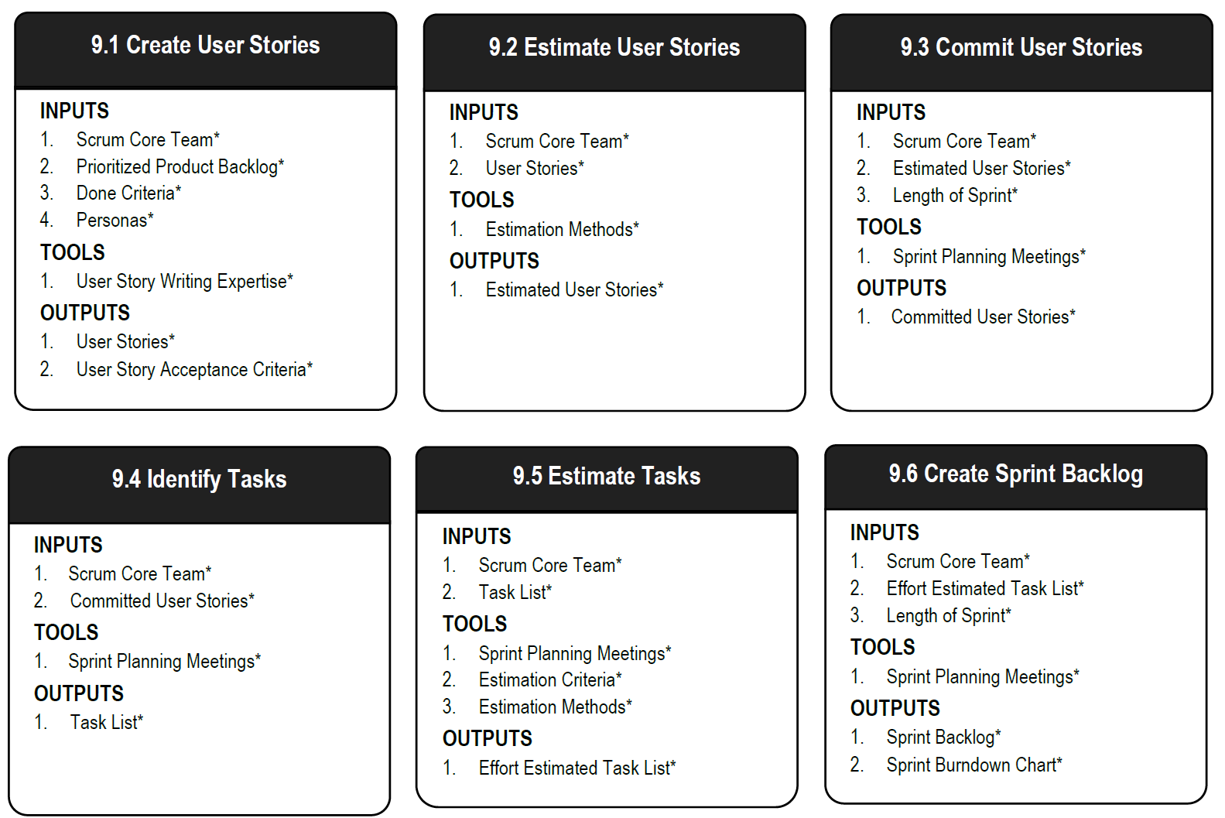
Scrum Phase - Plan and Estimate
Figure 9‑2: Plan and Estimate Overview (Essentials); SBOK Page 184
Additional Details: SBOK Pages 181-211

Slide 333
Plan and Estimate – Create User Stories
Scrum Core Team*
Prioritized Product Backlog*
Done Criteria*
Personas*
Stakeholder(s)
Epic(s)
Business Requirements
Laws and Regulations
Applicable Contracts
Scrum Guidance Body Recommendations
User Story Writing Expertise*
User Story Workshops
User Group Meetings
Focus Group Meetings
Customer or User Interviews
Questionnaires
Scrum Guidance Body Expertise
User Stories*
User Story Acceptance Criteria*
Updated Prioritized Product Backlog
Updated or Refined Personas
Figure 9‑3: Create User Stories—Inputs, Tools, and Outputs; SBOK Page 185

Slide 334
Create User Stories: Critical Tools -
User Story Writing Expertise
The Product Owner, based on his or her interaction with the stakeholders, business knowledge and expertise, and inputs from the team, develops User Stories that will form the initial Prioritized Product Backlog for the project.
The Prioritized Product Backlog represents the total sum of what must be completed for the project.
The objective of this exercise is to create elaborated and refined User Stories that can be estimated, and committed to by the Scrum Team.
At times, the Product Owner may bring a Business Analyst to assist with writing User Stories.
Although the Product Owner has the primary responsibility for writing User Stories and often carries out this exercise on his or her own, a User Story Writing Workshop can be held if desired.

Slide 335
Create User Stories: Critical Outputs -
User Stories
User Stories adhere to a specific, predefined structure and are a simplistic way of documenting the requirements and desired end-user functionality.
A User Story tells you three things about the requirement: Who, What, and Why.
The predefined, standard format results in enhanced communication among the stakeholders and better estimations by the team.
The Prioritized Product Backlog is a dynamic list that is continuously updated because of reprioritization and new, updated, refined, and sometimes, deleted User Stories.

Slide 336
Create User Stories: Critical Outputs -
User Story Acceptance Criteria
Every User Story has an associated Acceptance Criteria.
User Stories are subjective, so the Acceptance Criteria provide the objectivity required for the User Story to be considered as Done or not Done during the Sprint Review.
Acceptance Criteria provide clarity to the team on what is expected of a User Story, remove ambiguity from requirements, and help in aligning expectations.
The Product Owner defines and communicates the Acceptance Criteria to the Scrum Team.
In the Sprint Review Meetings, the Acceptance Criteria provide the context for the Product Owner to decide if a User Story has been completed satisfactorily.
It is important and the responsibility of the Scrum Master to ensure that the Product Owner does not change the Acceptance Criteria of a committed User Story in the middle of a Sprint.

Slide 337
Case Study - User Stories & Acceptance Criteria
Epic 1 - As a user David, I should be able to login to my account, so that I could have all the important information stored for future use.
User Story - As a user David, I would like to create an account, so that I could login to my account.
Acceptance Criteria - The account creation page should allow the account to be created with both email address as well as mobile number.

Slide 338
Case Study - User Stories & Acceptance Criteria
Epic 2 - As a user David, I should be able to make purchases online so that I could make purchase without going to the store.
User Story –
Acceptance Criteria -
User Story –
Acceptance Criteria -

Slide 339
Plan and Estimate – Estimate User Stories
Scrum Core Team*
User Stories*
Scrum Guidance Body Recommendations
Sprint Planning Meetings
Prioritized Product Backlog Review Meetings
Estimation Methods*
Estimated User Stories*
Updated Prioritized Product Backlog
Updated User Acceptance Criteria
Figure 9‑5: Estimate User Stories—Inputs, Tools, and Outputs; SBOK Page 191

Slide 340
Estimate User Stories: Critical Outputs –
Estimated User Stories
Relative sizing, or story points can be used for estimating the overall size of a User Story or feature.
This approach assigns a story point value based on an overall assessment of the size of a User Story with consideration given to risk, amount of effort required, and level of complexity.
This assessment will be conducted by the Scrum Team and a story point value will be assigned.
Once an evaluation is done on one User Story in the Prioritized Product Backlog, the Scrum Team can then evaluate other User Stories relative to that first story.
It should be noted that since the story point calibration for each team would be different, the number of story points completed could not be used for comparison across teams.

Slide 341
Plan and Estimate – Commit User Stories
Scrum Core Team*
Estimated User Stories*
Length of Sprint*
Previous Sprint Velocity
Scrum Guidance Body Recommendations
Sprint Planning Meeting*
Committed User Stories*
Figure 9‑7: Commit User Stories—Inputs, Tools, and Outputs; SBOK Page 196

Slide 342
Commit User Stories: Critical Tools –
Sprint Planning Meetings
In Sprint Planning Meetings, the Scrum Team gets together to plan the work to be done in the Sprint.
The team reviews the Estimated User Stories at the top of the Prioritized Product Backlog.
The Product Owner is present during this meeting in case clarification of User Stories or priorities are required.
To help ensure that the group stays on topic, this meeting should be Time-boxed, with the standard length limited to two hours per week of Sprint duration.
This assists in preventing the tendency to stray into discussions that should actually occur in other meetings, like the Release Planning or Sprint Review Meetings.
As part of this meeting the entire Scrum Team will commit to delivering a subset of User Stories from the Prioritized Product Backlog in the Sprint.

Slide 343
Commit User Stories: Mandatory Tools –
Communication Techniques
Scrum promotes accurate and effective communication primarily through colocation of the Scrum Team.
Scrum also favors informal, face-to-face interactions over formal written communications.
When a Scrum Team needs to be distributed, the Scrum Master should ensure that effective communication techniques are available so that the team can self-organize, collaborate, and work effectively

Slide 344
Commit User Stories: Mandatory Outputs –
Committed User Stories
The Scrum Team commits to a subset of Estimated User Stories that they believe they can complete in the next Sprint based upon velocity.
The Committed User Stories should always be selected per the priorities defined by the Product Owner.

Slide 345
Plan and Estimate – Identify Tasks
Scrum Core Team*
Committed User Stories*
Sprint Planning Meetings*
Decomposition
Dependency Determination
Task List*
Updated Committed User Stories
Dependencies
Figure 9‑9: Identify Tasks—Inputs, Tools, and Outputs; SBOK Page 199

Slide 346
Identify Tasks: Critical Outputs –
Task List
This is a comprehensive list that contains all the tasks to which the Scrum Team has committed for the current Sprint.
It contains descriptions of each task along with estimates derived during the Identify Tasks process.
The Task List must include any testing and integration efforts so that the Product Increment from the Sprint can be successfully integrated into the deliverables from previous Sprints.
Even though tasks are often activity based, the level of granularity to which the tasks are decomposed is decided by the Scrum Team

Slide 347
Plan and Estimate – Estimate Tasks
Scrum Core Team*
Task List*
User Story Acceptance Criteria
Dependencies
Identified Risks
Scrum Guidance Body Recommendations
Sprint Planning Meetings*
Estimation Criteria*
Estimation Methods*
Effort Estimated Task List*
Figure 9‑7: Estimate Tasks—Inputs, Tools, and Outputs; SBOK Page 203

Slide 348
Identify Tasks: Critical Tools –
Estimation Criteria
Estimation Criteria can be expressed in numerous ways, with two common examples being story points and ideal time.
Story point values are used to represent relative, or comparative effort to complete tasks.
Ideal time normally describes the number of hours a Scrum Team member works exclusively on developing the project’s deliverables, without including any time spent on other activities or work that is outside the project.
Estimation Criteria make it easier for the Scrum Team to estimate effort and enable them to evaluate and address inefficiencies when necessary.

Slide 349
Identify Tasks: Critical Outputs –
Effort Estimated Task List
The Effort Estimated Task List is a list of tasks associated with the Committed User Stories included in a Sprint.
Estimated effort is expressed in terms of the Estimation Criteria agreed on by the team.
The Effort Estimated Task List is used by the Scrum Team during Sprint Planning Meetings to create the Sprint Backlog and Sprint Burndown Chart.
It is also used to determine when the team needs to reduce its commitment, or can take on additional User Stories during Sprint Planning.

Slide 350
Plan and Estimate – Create Sprint Backlog
Scrum Core Team*
Effort Estimated Task List*
Length of Sprint*
Dependencies
Team Calendar
Sprint Planning Meeting*
Sprint Tracking Tools
Sprint Tracking Metrics
Sprint Backlog*
Sprint Burndown Chart*
Figure 9‑9: Create Sprint Backlog—Inputs, Tools, and Outputs; SBOK Page 207

Slide 351
Identify Tasks: Critical Outputs –
Sprint Backlog
The list of the tasks to be executed by the Scrum Team in the upcoming Sprint is called the Sprint Backlog.
It is common practice that the Sprint Backlog is represented on a Scrumboard or task board, which provides a constantly visible depiction of the status of the User Stories in the backlog.
Also included in the Sprint Backlog are any risks associated with the various tasks. Any mitigating activities to address the identified risks would also be included as tasks in the Sprint Backlog.
Once the Sprint Backlog is finalized and committed to by the Scrum Team, new User Stories should not be added; however, tasks that might have been missed or overlooked from the committed User Stories may need to be added.
If new requirements arise during a Sprint, they will be added to the overall Prioritized Product Backlog and included in a future Sprint.

Slide 352
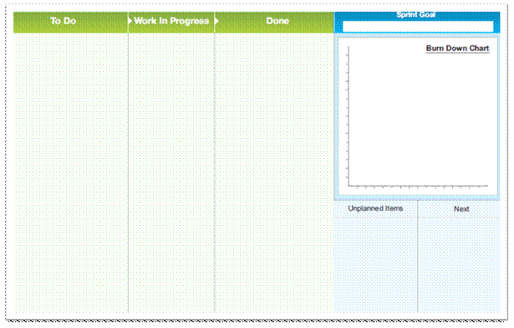
Scrumboard - Beginning of a Sprint

Slide 353
Identify Tasks: Mandatory Outputs –
Sprint Burndown Chart
The Sprint Burndown Chart is a graph that depicts the amount of work remaining in the ongoing Sprint.
The initial Sprint Burndown Chart is accompanied by a planned burndown.
The Sprint Burndown Chart should be updated at the end of each day as work is completed.
If the Sprint Burndown Chart shows that the Scrum Team is not on track to finish the tasks in the Sprint on time, the Scrum Master should identify any obstacles or impediments to successful completion and try to remove them.
A related chart is a Sprint Burnup Chart. Unlike the Sprint Burndown Chart which shows the amount of work remaining, the Sprint Burnup Chart depicts the work completed as part of the Sprint.

Slide 354
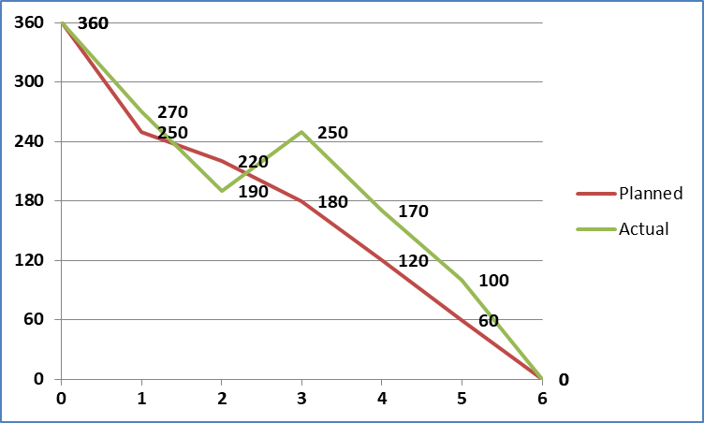
Identify Tasks: Mandatory Outputs –
Sprint Burndown Chart
Story Points
Sprints

Slide 355
Question
Which of the following is a meeting that is held during the Plan and Estimate phase of a Scrum Project?
Daily Standup Meeting
Sprint Planning Meeting
Sprint Review Meeting
Release Planning Meeting

Slide 356
Answers Will be Provided by the Faculty

Slide 357
Question
Choose the correct sequential order of the processes in the Plan and Estimate Phase?
Identify Tasks, Estimate Tasks, Create User Stories, Estimate User Stories, and Create Sprint Backlog.
Create User Stories, Identify Tasks, Estimate User Stories, Estimate Tasks, and Create Sprint Backlog.
Create Sprint Backlog, Create User Stories, Estimate User Stories, Identify Tasks, and Estimate Tasks.
Create User Stories, Estimate User Stories, Identify Tasks, Estimate Tasks, and Create Sprint Backlog.

Slide 358
Answers Will be Provided by the Faculty

Slide 359
Question
The responsibility for estimating items in the Prioritized Product Backlog in the Plan and Estimate phase lies with the:
Scrum Team.
Scrum Master.
Product Owner.
External team with considerable experience.

Slide 360
Answers Will be Provided by the Faculty

Slide 361
Question
Which of the following best defines Task List?
It is a comprehensive list that contains all the tasks to which the Scrum Team has committed for the current Sprint.
It describes the relationship and interaction between different tasks in a project.
It refers to the priority order of the completed deliverable to meet its Acceptance Criteria.
None of the above

Slide 362
Answers Will be Provided by the Faculty

Slide 363
If you have any additional questions on this topic, please post it in the Question window.
Case Study - Issues with Developing the Sprint Backlog
Scrum Master has approached the Product Owner stating that the Scrum Team is struggling to understand few User Stories within the Product Backlog? What are the initial steps that the Product Owner needs to implement to address this issue? Please type your answer in the Question window.

Slide 364
If you have any additional questions on this topic, please post it in the Question window.
Case Study - Issues with Developing the Sprint Backlog
There is a change request from one of the key stakeholders and they want the change to be implemented in the current Sprint. What course of action should the Product Owner resort to? Please type your answer in the Question window.

Slide 365
Scrum Phases - Implement

Slide 366
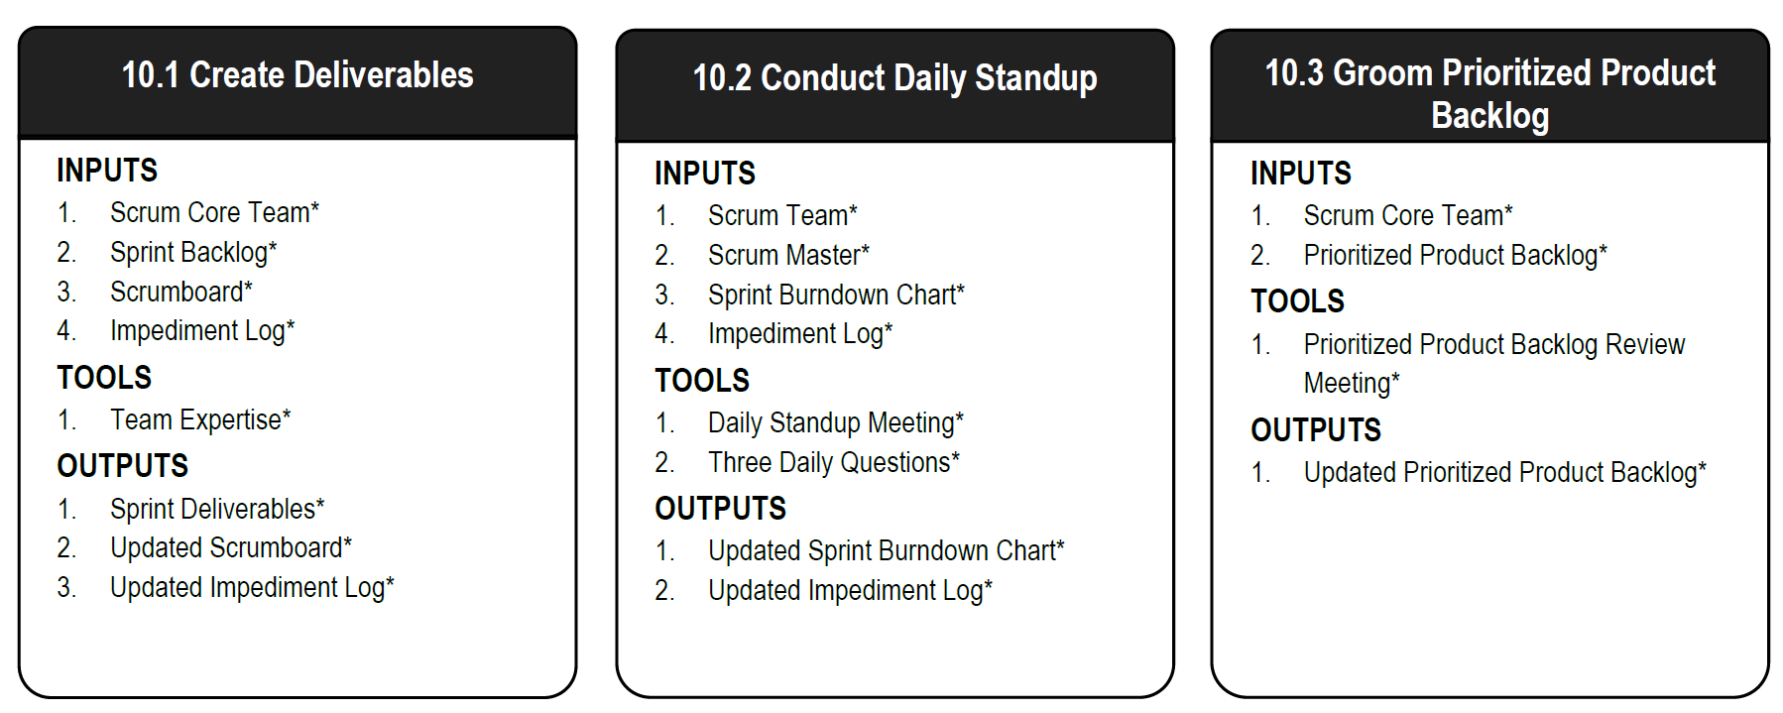
Scrum Phase - Implement
Figure 10‑2: Implement Overview (Essentials); Page 216
Additional Details: SBOK Page 213-233

Slide 367
Implement – Create Deliverables
Scrum Core Team*
Sprint Backlog*
Scrumboard*
Impediment Log*
Release Planning Schedule
Dependencies
Scrum Guidance Body Recommendations
Team Expertise*
Software
Other Development Tools
Scrum Guidance Body Expertise
Sprint Deliverables*
Updated Scrumboard*
Updated Impediment Log*
Unapproved Change Requests
Identified Risks
Mitigated Risks
Updated Dependencies
Figure 10‑3: Create Deliverables—Inputs, Tools, and Outputs; Page 217

Slide 368
Implement - Changes to a Sprint
There is only one exception to the rule about not changing the scope of a Sprint once a Sprint begins.
If the Scrum Team determines it has heavily overestimated the effort during the Sprint and has spare capacity to implement additional User Stories, the team can ask the Product Owner which additional User Stories should be included in the current Sprint.
An additional benefit is that the team does not have to worry about managing changes once they start working on a Sprint.

Slide 369
Create Deliverables: Critical Inputs –
Impediment Log
An impediment is any hindrance or hurdle that reduces the productivity of the Scrum Team. Impediments must be identified, resolved and removed if the team is to continue working effectively.
Impediments can be internal to the team, such as inefficient workflow or lack of communication; or they can be external, such as software license issues, legal or government compliance requirements etc.
Impediments should be formally recorded by the Scrum Master in an Impediment Log.

Slide 370
Create Deliverables: Critical Tools –
Team Expertise
This refers to the collective expertise of the Scrum Team members to understand the User Stories and tasks in the Sprint Backlog in order to create the final deliverables.
Scrum Team members have the authority and responsibility to determine the best means for converting the Prioritized Product Backlog Items into finished products, without requiring involvement of any stakeholders outside the team.
Additional expertise is available from the Scrum Guidance Body, as required.

Slide 371
Create Deliverables: Critical Outputs –
Sprint Deliverables
At the end of each Sprint, a product increment or deliverable is completed.
The deliverable should possess all features and functionality defined in the User Stories included in the Sprint and should have been tested successfully

Slide 372
Create Deliverables: Use of the Scrumboard
Below is the picture of a Scrumboard at the end of the Sprint. Was that a good Sprint? A bad one? An OK one? What do you think? Please type your answer in the Question window.

Slide 373
Create Deliverables: Use of the Scrumboard
Below is the picture of a Scrumboard at the end of the same Sprint. Is that better, worse or the same? Why? Please type your answer in the Question window.

Slide 374
Implement – Conduct Daily Standup
Scrum Team*
Scrum Master*
Sprint Burndown Chart*
Impediment Log*
Product Owner
Previous Work Day Experience
Scrumboard
Dependencies
Daily Standup Meeting*
Three Daily Questions*
War Room
Video Conferencing
Updated Sprint Burndown Chart*
Updated Impediment Log*
Motivated Scrum Team
Updated Scrumboard
Unapproved Change Requests
Identified Risks
Mitigated Risks
Updated Dependencies
Figure 10‑6: Conduct Daily Standup—Inputs, Tools, and Outputs; Page 223

Slide 375
Conduct Daily Standups: Critical Tools –
Daily Standup Meeting
The Daily Standup Meeting is a short daily meeting, Time-boxed to 15 minutes.
Team members assemble to report their progress in the Sprint and plan the day’s activities.
In the meeting, each Scrum Team member provides answers to the Three Daily Questions.
Discussions between the Scrum Master and the team or between some Scrum Team members are encouraged, but such discussions happen after the meeting to ensure that the Daily Standup Meeting is short.

Slide 376
Conduct Daily Standups: Critical Tools –
Three Daily Questions
In the Daily Standup Meeting, facilitated by the Scrum Master, each Scrum Team member provides information in the form of answers to three specific questions:
What have I done since the last meeting?
What do I plan to do before the next meeting?
What impediments or obstacles (if any) am I currently facing?
It is highly recommended that the first two questions should be answered by team members in a quantifiable manner if possible, instead of qualitative lengthy answers.
Team members can organize additional meetings after the daily Standup Meeting to address items that need additional discussion.

Slide 377
Conduct Daily Standups: Critical Outputs –
Updated Sprint Burndown Chart
The Sprint Burndown Chart is a graph that depicts the amount of work remaining in the ongoing Sprint. The initial Sprint Burndown Chart is accompanied by a planned burndown.
The Sprint Burndown Chart should be updated at the end of each day as work is completed.

Slide 378
Implement – Groom Prioritized Product Backlog
Scrum Core Team*
Prioritized Product Backlog*
Rejected Deliverables
Approved Change Requests
Unapproved Change Requests
Identified Risks
Updated Program Product Backlog
Retrospect Sprint Log(s)
Dependencies
Release Planning Schedule
Scrum Guidance Body Recommendations
Prioritized Product Backlog Review Meetings*
Communication Techniques
Other Prioritized Product Backlog Grooming Techniques
Updated Prioritized Product Backlog*
Updated Release Planning Schedule
Figure 10‑8: Groom Prioritized Product Backlog—Inputs, Tools, and Outputs; Page 228

Slide 379
Groom Prioritized Product Backlog: Critical Tools - Prioritized Product Backlog Review Meetings
The Product Owner may have multiple and separate meetings with relevant Stakeholder(s), the Scrum Master, and the Scrum Team to ensure that he or she has enough information to make updates to the Prioritized Product Backlog during the Groom Prioritized Product Backlog process.
The intent of the Prioritized Product Backlog Review Meetings is to ensure that User Stories and Acceptance Criteria are understood and are written properly by the Product Owner so that they reflect the actual stakeholder (customer) requirements and priorities

Slide 380
Groom Prioritized Product Backlog: Critical Outputs – Updated Prioritized Product Backlog
Prioritized Product Backlog may be updated with new User Stories, new Change Requests, new Identified Risks, updated User Stories, or reprioritization of existing User Stories.
A minimum requirement for the grooming is that at the beginning of every Sprint enough items with the top priorities in the Product Backlog are refined well enough so that the team is able to commit to them and to create the associated deliverables in the upcoming Sprint.

Slide 381
Question
Which of the following processes is not a part of the Implement phase?
Create Sprint Backlog.
Conduct Daily Standup.
Create Deliverables.
Groom Prioritized Product Backlog.

Slide 382
Answers Will be Provided by the Faculty

Slide 383
Question
You are the Scrum Master on a project to develop equipment to conduct mining in hazardous areas. You hold a Daily Standup with the Scrum Team where every team member answers three questions. In this meeting all the following will be carried out except:
Identify problems and impediments each team member is facing
Identify solutions to the problems raised by team members
Track progress of each team member
Only 1
Both 1 and 3
Only 2
Both 1 and 2

Slide 384
Answers Will be Provided by the Faculty

Slide 385
Question
How often can the Prioritized Product Backlog priorities be changed?
Never
Whenever the Product Owner decides that an item has to be assigned higher priority
Whenever the Scrum Master believes that an item has to be added
When senior management feels an item has to be added

Slide 386
Answers Will be Provided by the Faculty

Slide 387
Question
What is team velocity?
It is a metric used to measure and contrast the teams performance.
It is a meeting conducted to measure team’s performance.
It is a tool used to assess User Stories.
It is a mandatory input to Review and Retrospect process.

Slide 388
Answers Will be Provided by the Faculty

Slide 389
If you have any additional questions on this topic, please post it in the Question window.
Question Case Study - Possible Issues
As a Product Owner you attend the Daily Standup Meeting of one of your Scrum Teams. You are not satisfied with the progress that has been made in the last week. What is the course of action you would take in this context? Please type your answer in the Question window.

Slide 390
If you have any additional questions on this topic, please post it in the Question window.
Question
One of the board members wants to be a part of the Daily Standup Meetings of your Scrum Teams. What guidelines on Daily Standup Meetings will you, as a Product Owner, communicate to that member? Please type your answer in the Question window.

Slide 391
Scrum Phases - Review and Retrospect

Slide 392
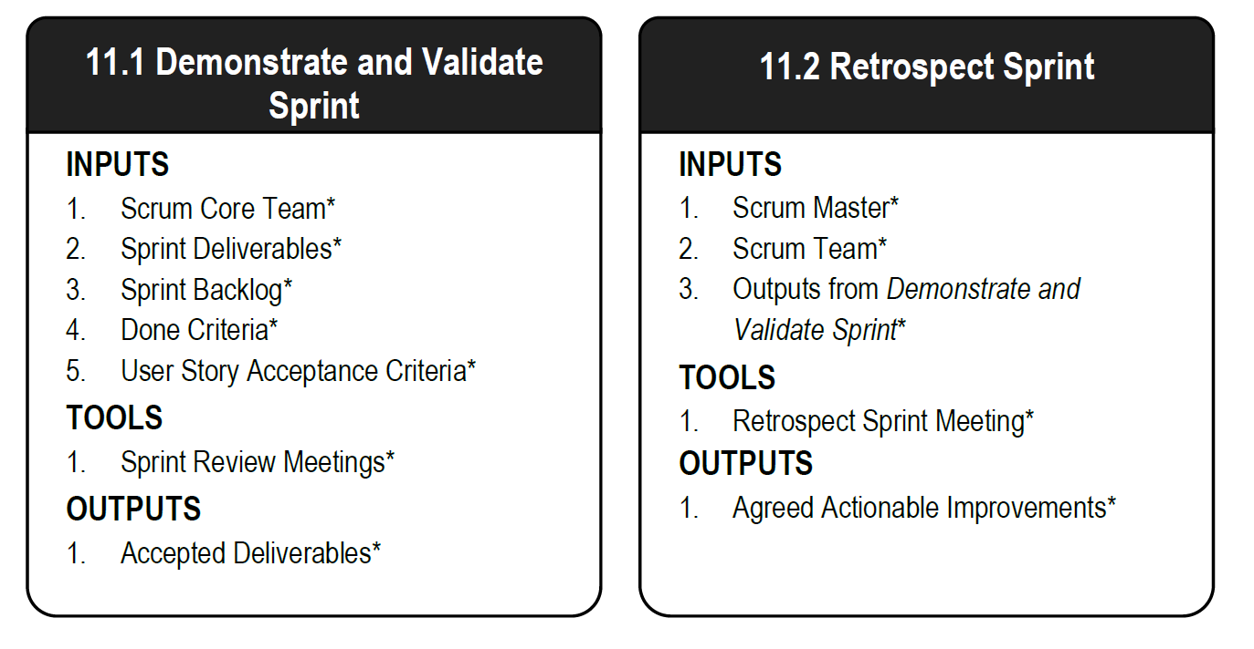
Scrum Phase - Review and Retrospect
Figure 11‑2: Review and Retrospect Overview; SBOK Page 239
Additional Details: SBOK Pages 235-247

Slide 393
Review and Retrospect – Demonstrate and Validate Sprint
Scrum Core Team*
Sprint Deliverables*
Sprint Backlog*
Done Criteria*
User Story Acceptance Criteria*
Stakeholder(s)
Release Planning Schedule
Identified Risks
Dependencies
Scrum Guidance Body Recommendations
Sprint Review Meetings*
Earned Value Analysis
Scrum Guidance Body Expertise
Accepted Deliverables*
Rejected Deliverables
Updated Risks
Earned Value Analysis Results
Updated Release Planning Schedule
Updated Dependencies
Figure 11‑3: Demonstrate and Validate Sprint—Inputs, Tools, and Outputs; SBOK Page 237

Slide 394
Demonstrate and Validate Sprint: Critical Tools Sprint Review Meeting
The Scrum Core Team members and relevant Stakeholder(s) participate in Sprint Review Meetings to accept the deliverables which meet the User Story Acceptance Criteria and reject unacceptable deliverables.
These meetings are convened at the end of every Sprint.
The Scrum Team demonstrates the achievements from the Sprint, including the new functionalities or products created.
This provides an opportunity for the Product Owner and Stakeholder(s) to inspect what has been completed so far and to determine if any changes should be made in the project or processes in subsequent Sprints

Slide 395
Demonstrate and Validate Sprint: Critical Outputs - Accepted Deliverables
Deliverables which meet the User Story Acceptance Criteria are accepted by the Product Owner.
These are considered Accepted Deliverables that may be released to the customer if they so desire.
A list of Accepted Deliverables is maintained and updated after each Sprint Review Meeting.

Slide 396
Demonstrate and Validate Sprint: Outputs - Rejected Deliverables
If Deliverables do not meet the Acceptance Criteria, such Deliverables are rejected.
User Stories associated with such Rejected Deliverables get added to the Prioritized Product Backlog so that such deliverables may be considered as part of a subsequent Sprint.

Slide 397
Review and Retrospect – Retrospect Sprint
Scrum Master*
Scrum Team*
Outputs from Demonstrate and Validate Sprint*
Product Owner
Scrum Guidance Body Recommendations
Retrospect Sprint Meeting*
ESVP
Speed Boat
Metrics and Measuring Techniques
Scrum Guidance Body Expertise
Agreed Actionable Improvements*
Assigned Action Items and Due Dates
Proposed Non-Functional Items for Prioritized Product Backlog
Retrospect Sprint Log(s)
Scrum Team Lessons Learned
Updated Scrum Guidance Body Recommendations
Figure 11‑5: Retrospect Sprint—Inputs, Tools, and Outputs; SBOK Page 242

Slide 398
Retrospect Sprint: Critical Tools –
Retrospect Sprint Meeting
The Retrospect Sprint Meeting is an important element of the ‘inspect-adapt’ Scrum framework and it is the final step in a Sprint.
All Scrum Team members attend the meeting, which is facilitated or moderated by the Scrum Master. It is recommended, but not required for the Product Owner to attend.
Discussions in the Retrospect Sprint Meeting encompass both what went wrong and what went right.

Slide 399
Retrospect Sprint: Critical Tools –
Retrospect Sprint Meeting
Primary objectives of the meeting are to identify three specific items:
Things the team needs to keep doing: best practices
Things the team needs to begin doing: process improvements
Things the team needs to stop doing: process problems and bottlenecks
These areas are discussed and a list of Agreed Actionable Improvements is created

Slide 400
Retrospect Sprint: Critical Output –
Agreed Actionable Improvements
Agreed Actionable Improvements are the list of actionable items that the team has come up with to address problems and improve processes in order to enhance their performance in future Sprints

Slide 401
Question
The meeting at the end of the Sprint in which the team presents its work to the Product Owner is known as the:
Product Vision Meeting.
Sprint Planning Meeting.
Sprint Review Meeting.
Retrospect Sprint Meeting.

Slide 402
Answers Will be Provided by the Faculty

Slide 403
Question
What is the objective of Demonstrate and Validate Sprint process?
To enable Scrum Team demonstrates the Sprint Deliverables to the Product Owner and relevant stakeholders in a Sprint Review Meeting.
To enable Scrum Team to discuss the lessons learned throughout the Sprint.
To enable Scrum Team to work on the tasks in the Sprint Backlog to create Sprint Deliverables.
To enable Scrum Team to continuously update and maintain the Prioritized Product Backlog.

Slide 404
Answers Will be Provided by the Faculty

Slide 405
If you have any additional questions on this topic, please post it in the Question window.
Question Case Study - Possible Issues during Sprint Review Meeting
Team member refuses to accept the decision of the Product Owner to reject a Product Backlog Item developed in the Sprint. What should the PO do? Please type your answer in the Question window.

Slide 406
If you have any additional questions on this topic, please post it in the Question window.
Question Case Study - Possible Issues during Sprint Review Meeting
Team members blame each other for failure to complete Sprint goals. What should a PO do? Please type your answer in the Question window.

Slide 407
Scrum Phases - Release

Slide 408
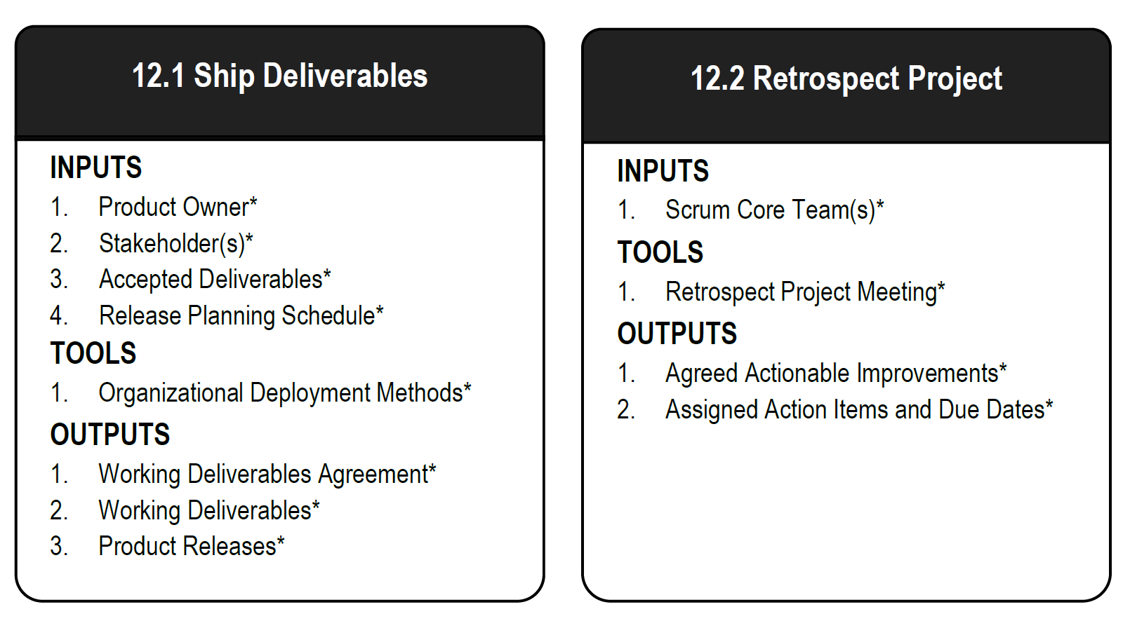
Scrum Phase - Release
Figure 12‑2: Release Overview (Essentials); SBOK Page 251
Additional Details: SBOK Pages 249-260

Slide 409
Release – Ship Deliverables
Product Owner*
Stakeholder(s)*
Accepted Deliverables*
Release Planning Schedule*
Scrum Master
Scrum Team
User Story Acceptance Criteria
Piloting Plan
Scrum Guidance Body Recommendations
Organizational Deployment Methods*
Communication Plan
Working Deliverables Agreement*
Working Deliverables*
Product Releases*
Figure 12‑3: Ship Deliverables—Inputs, Tools, and Outputs; SBOK Page 251
Additional Details: SBOK Pages 249-260

Slide 410
Ship Deliverables: Critical Tool –
Organizational Deployment Methods
The deployment mechanisms of each organization tend to be different based on their industry, target users, and positioning.
Depending on the product being delivered, deployment can take place remotely or may involve the physical shipping or transition of an item.
Deployment tends to involve a high level of risk, as such organizations normally have well-defined and established deployment mechanisms, with detailed processes in place to ensure compliance with any applicable standards and quality assurance measures.
These might include sign-offs by specific management representatives, user approval mechanisms, and guidelines regarding minimum functionality for a release.

Slide 411
Ship Deliverables: Critical Outputs –
Working Deliverables Agreement
Deliverables that meet the Acceptance Criteria receive formal business sign-off and approval by the customer or sponsor.
To get formal customer acceptance is critical for revenue recognition and the responsibility for obtaining it will be defined by the company policies and is not necessarily the responsibility of the Product Owner.

Slide 412
Ship Deliverables: Critical Outputs –
Working Deliverables
Working deliverables is the final shippable Deliverable for which the project was sanctioned.
As new product increments are created, they are continually integrated into prior increments, so there is a potentially shippable product available at all times throughout the project.

Slide 413
Ship Deliverables: Critical Outputs –
Product Releases
The Product Releases should include the following:
Release Content—This consists of essential information about the deliverables that can assist the Customer Support Team.
Release Notes—Release Notes should include external or market facing shipping criteria for the product to be delivered.

Slide 414
Release – Retrospect Project
Scrum Core Team(s)*
Chief Scrum Master
Chief Product Owner
Stakeholder(s)
Scrum Guidance Body Recommendations
Retrospect Project Meeting*
Other Tools for Retrospect Project
Scrum Guidance Body Expertise
Agreed Actionable Improvements*
Assigned Action Items and Due Dates*
Proposed Non-Functional Items for Program Product Backlog and Prioritized Product Backlog
Updated Scrum Guidance Body Recommendations
Figure 12‑5: Retrospect Project —Inputs, Tools, and Outputs; SBOK Page 256

Slide 415
Retrospect Project: Critical Tools –
Retrospect Project Meeting
The Retrospect Project Meeting is a meeting to determine ways in which team collaboration and effectiveness can be improved in future projects.
Positives, negatives, and potential opportunities for improvement are also discussed.
This meeting is not Time-boxed and may be conducted in person or in a virtual format.
Attendees include the Project Team, Chief Scrum Master, Chief Product Owner, and Stakeholder(s).
During the meeting, lessons learned are documented and participants look for opportunities to improve processes and address inefficiencies.

Slide 416
Retrospect Project: Critical Outputs
Agreed Actionable Improvements
Assigned Action Items and Due Dates
These topics have already been discussed

Slide 417
Question
You are a member of a Scrum Team, and you are instructed by the general manager of your company to work on an urgent task that is not part of the current Sprint. What do you do?
Take responsibility for the task, and tell the Product Owner to postpone the deadline for the current Sprint.
Talk with the other Scrum Team members and re-assign your tasks to someone else.
Talk to the Product Owner, and tell him or her to re-assign your tasks to someone else.
Inform the Scrum Master of the situation, and let him or her discuss the situation with the GM.

Slide 418
Answers Will be Provided by the Faculty

Slide 419
Question
Time-boxing is not done in which of the following meetings?
Daily Standup Meeting
Sprint Planning Meeting
Retrospect Project Meeting
Retrospect Sprint Meeting

Slide 420
Answers Will be Provided by the Faculty

Slide 421
If you have any additional questions on this topic, please post it in the Question window.
Question
Do you conduct Retrospect Project or similar meetings in your project and do you think it helps? Please type your answer in the Question window.

Slide 422

Transition to Scrum

Slide 423

Top Down

Slide 424

Bottom Up

Slide 425

Resistance to Change

Slide 426

Thank you!

